Slide 1
FTFMS Webinar for the FY18 Reporting Year
October 4, 2018

Slide 2
Feed the Future MEL Webinar Series
Intro to the MEL System
Standard Indicator Overview
New Indicators: Application of improved practices and technologies
New Indicators: Sales, finance, and investment
FY18 FTFMS Reporting (today!)
Nutrition, Sanitation & Hygiene Indicators (Oct 11)
New Indicators: Gender (Oct 17)
Reporting on Policy Change (Oct 30)
New Indicators: Yield and agroecological
Feed the Future Learning Agenda
Notes:
Here’s a list of the upcoming MEL webinars in this series. The full schedule is available online here: https://www.agrilinks.org/post/feed-the-future-mel-webinar-series

Slide 3
Katie West
Katie West
Anne Swindale
Lesley Perlman
Anna Brenes
Julie MacCartee
Zachary Baquet
Notes:
I’m your facilitator, Julie MacCartee, and our main speaker today will be Katie West, the FTFMS System Administrator and manager of the performance reporting process for the Feed the Future (FTF) Initiative. She is a member of the MEL team in BFS HQ in Washington.
We also have a suite of colleagues from BFS/MEL on hand to answer your questions.
I’ll now turn it over to Katie West to get us started.

Slide 4
Agenda
Welcome & Intro
Glossary & other resources
FTFMS Overview
Basic Reporting Requirements
Timeline for Data Entry
Key Changes & Highlights for FY18
New Handbook
Transition to new indicators
Narrative changes
Live Demo!
Tips
Tricky Indicator instructions
Q&A

Slide 5
FTFMS Overview

Slide 6
FTFMS Overview
Feed the Future Monitoring System (FTFMS)
Initiative with 11 USG Agencies [6 reporting into FTFMS]
For USAID, our work with EG.3 Ag funds or HL.9 Nutrition funds counts as FTF; Other USG Agencies decide what’s appropriate
Annual reporting by Partners, Offices, Country Posts, Missions
Contains over 2500 Activities; ~600-700 active/yr
Has over 1000 users

Slide 7
FTFMS Overview
Data aggregated & used for:
Producing the Progress Report
Answering Congress
Justifying budget requests
Annual Performance Reviews @ Country Level
Informing Front Office decisions
Engaging with stakeholders
Influencing policy and programming decisions

Slide 8
Basic Reporting Req’s FY18
USAID Implementing Partner (IP) | USAID OU | Interagency
Enter indicator results & targets for IM-level data Review data for accuracy Submit to OU | Enter indicator results & targets for OU-level data Review *both* OU and IM data for accuracy Approve in FTFMS | Enter indicator results & targets Review data for accuracy Approve in FTFMS
Write and submit your IM Performance Narrative | Write and submit your FTF Key Issue Narrative | Write and submit your Program-level Narrative

Slide 9
Timeline FY18
System OPENS: Monday, Oct 15
System DEADLINES:
FOR USAID:
IP Data due to OUs for review: Friday, Nov 16
OUs approval of data in FTFMS: Nov 30
BFS HQ MEL TA Review & OU / IP Corrections: Dec 1 – Feb 14
FOR INTERAGENCY:
Data approved by: Friday, Jan 18; Reviewed Jan 21 – Feb 14
FOR USAID / FFP:
Data approved by: Friday, Jan 25; Reviewed Jan 28 – Feb. 14
***ALL DATA due in FINAL form: Friday, Feb 15***

Slide 10
Key Changes & Highlights for FY18

Slide 11
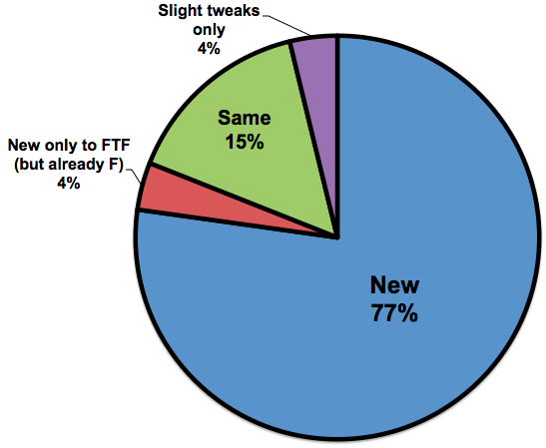
Key Changes & Highlights FY18
New FTF Indicator Handbook – March 2018!
79 Indicators:
Two ways to organize:
54 performance (we’re accountable!)
27 IM-level
6 National-level
1 Multi-level
20 ZOI-level
25 context (info / observations!)
17 National-level
5 ZOI-level
1 Global-level
2 Recurrent Crisis Area-level

Slide 12
Key Changes & Highlights FY18:
Transitioning
to the New Indicators

Slide 13
Transition to the New Indicators
You’re grandfathered in!
IMs / Activities ending before / in FY2019 -->> Keep using old (2016) set of indicators to finish out reporting!
IMs / Activities that are new or that end after FY2019 -->> Make the switch!
This year = Results in the OLD ones; Targets in NEW
Next year = Results & Targets in NEW
Exception! --> Can use new ones if you fully align with definition

Slide 14
Transition to the New Indicators
Do NOT report results on both the old and new indicator!!
e.g. EG.3.2-17 and EG.3.2-24;
EG.3.2-18 and EG.3.2-25; FTF01 and EG.3-2 For each 'pair' of indicators, report results in either the new or old and set targets in the new.

Slide 15
Key Changes & Highlights FY18:
FY18 Changes to the Narratives

Slide 16
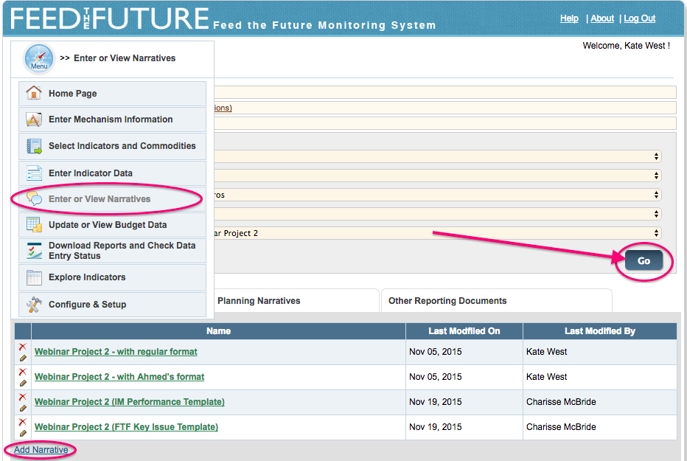
How to Enter Narratives

Slide 17
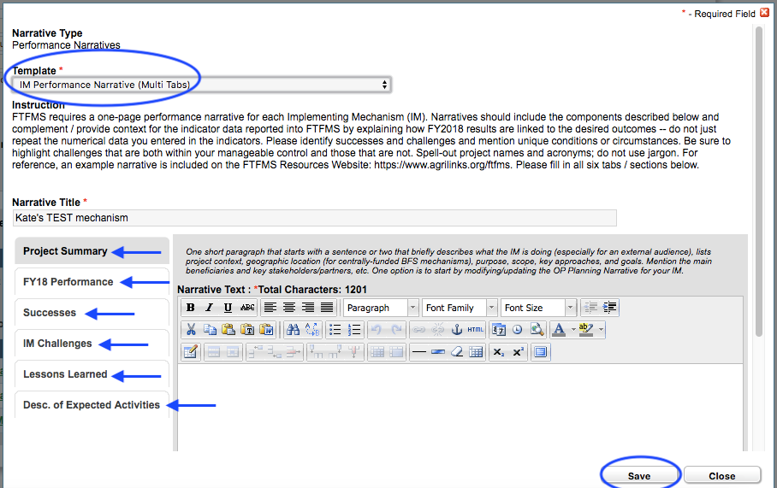
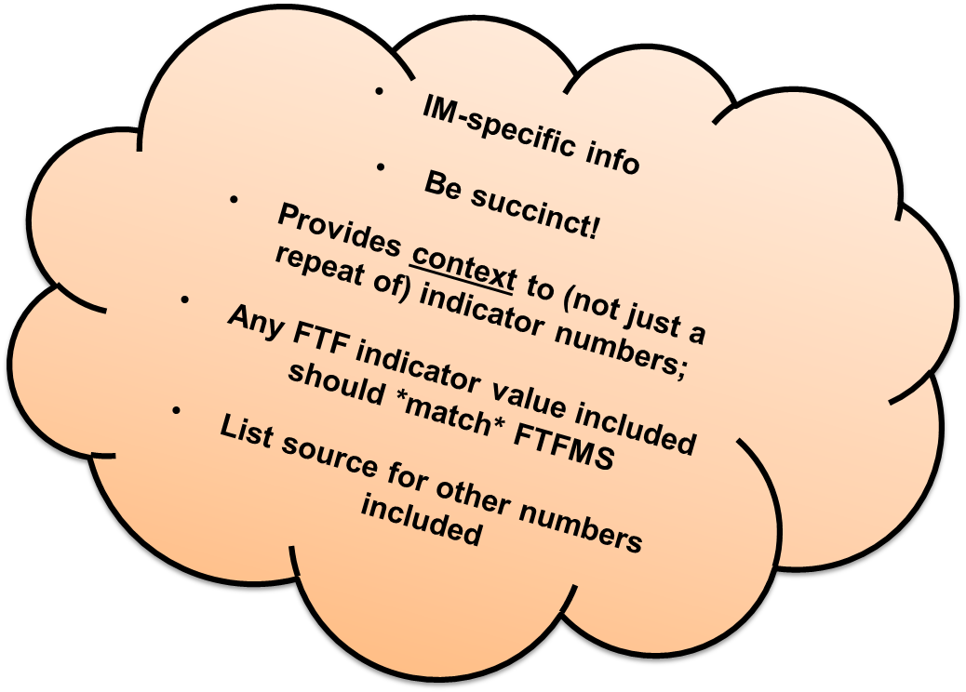
Narratives: IM Performance – all USAID IMs

Slide 18
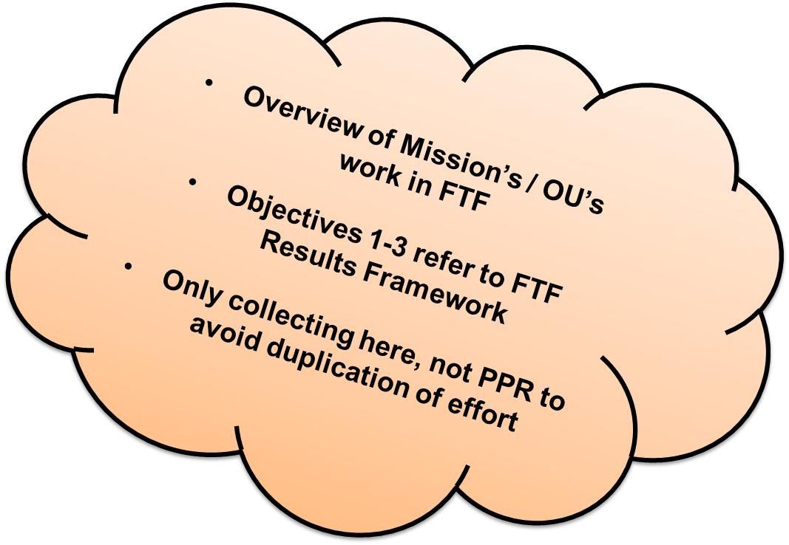
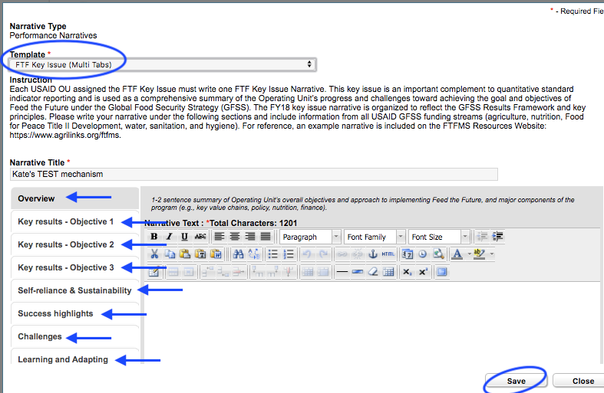
Narratives: FTF Key Issue - USAID OUs only

Slide 19
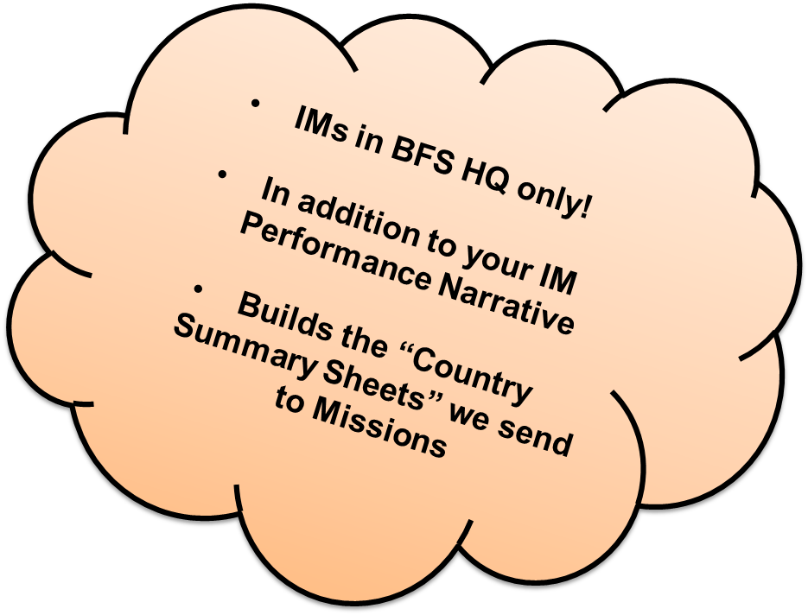
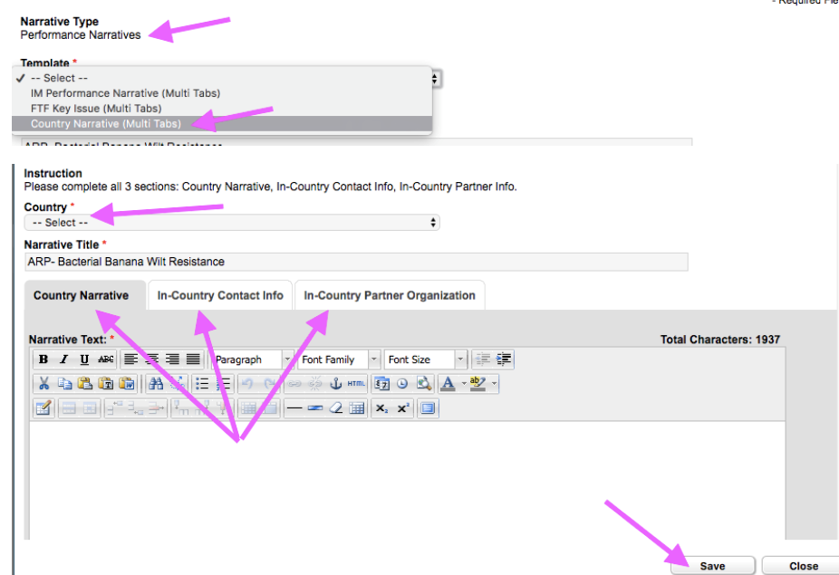
Narratives: Country Summary - **BFS HQ IMs only!**

Slide 20
YOU ARE RESPONSIBLE FOR YOUR DATA.
IT MUST BE COMPLETE and CORRECT!

Slide 21
Live Demo!

Slide 22
Live Demo! Demo site click here
Live website: www.ftfms.net
Training website: www.training.ftfms.net
Username: add “TRN_”, like TRN_kawest@usaid.gov
Password: same as live site

Slide 23
FTFMS Data Entry Checklist
AORs/CORs/AMs need to:
Check all IMs are listed in FTFMS
Fill in missing/incomplete IM Details
Add IM contact, especially AOR/COR/AM
Add IM location, down to granular level
Select Indicators & Commodities
Click “Start Data Entry”
IPs need to:
Enter IM-level indicator results & out-year targets
Enter IM Performance Narrative
Double check for accuracy and completeness.
IP submit to OU / Mission
OUs need to:
Enter OU-level indicator results & out-year targets
Enter FTF Key Issue Narrative
Review all IM-level *and* OU-level indicator & narrative data
OU / Mission reviews & approves all data in system

Slide 24
Tips & Reminders

Slide 25
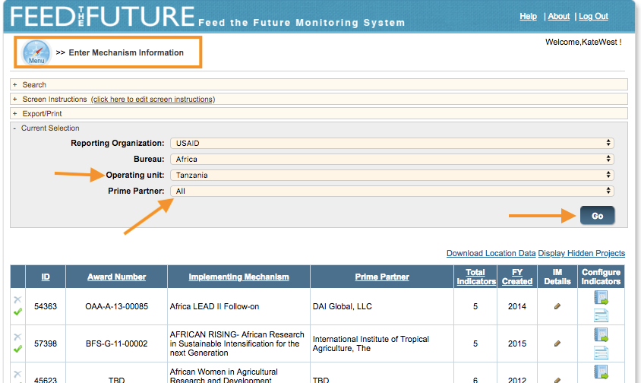
Tips & Reminders
For USAID OUs: IMs entered into your OP in FACTSInfo auto feed into FTFMS nightly. Check your IM list!

Slide 26
Tips & Reminders
Zero is a *real* number. Do not put a zero when you mean a blank or no data.

Slide 27
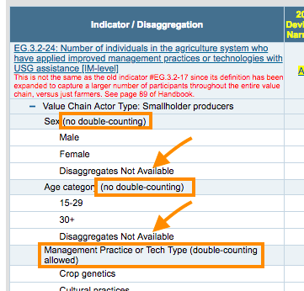
Tips & Reminders
Enter data at disaggregate level and FTFMS rolls up
Some disaggregates allow double-counting, some do not [a pop-up window with a validation message will appear if there’s error!]
Disaggregates *REQUIRED* but “DNA” available

Slide 28
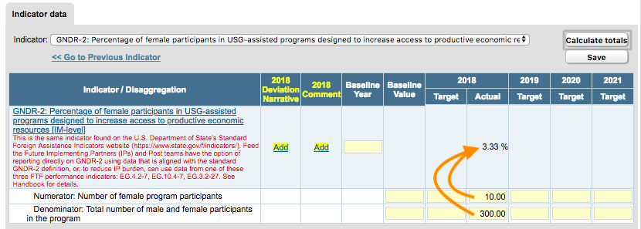
Tips & Reminders
Calculations exist on-screen (example below) and in reports
Reports not available until late Nov!

Slide 29
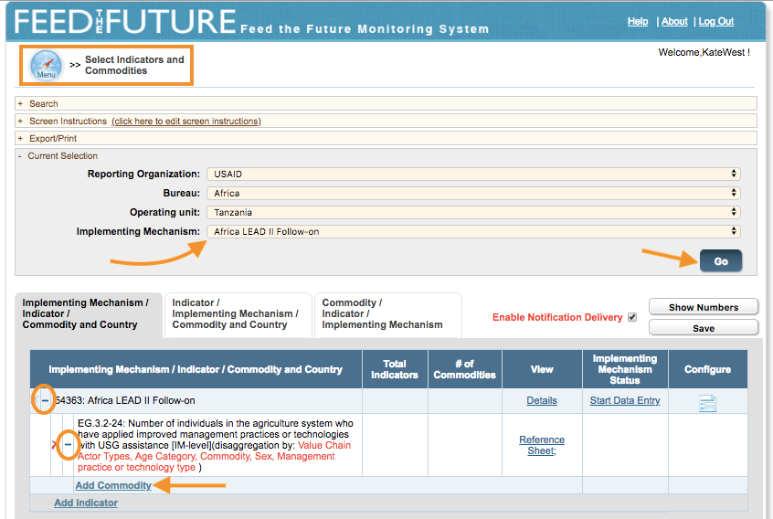
Tips & Reminders
Must add commodities first for all commodity indicators!

Slide 30
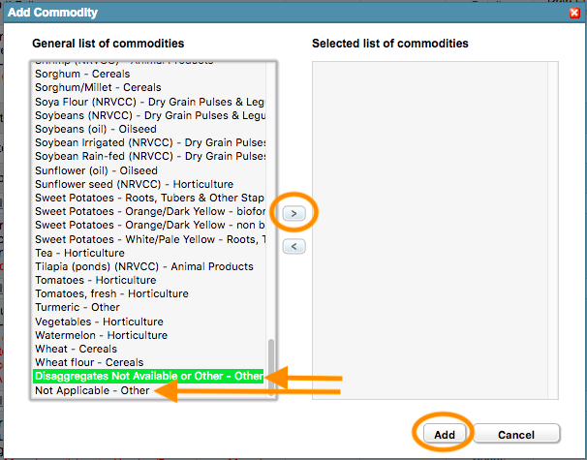
Tips & Reminders
If you don’t have commodity specifics, but reporting under a commodity indicator, you *still* have to choose a commodity for data entry cells to appear -->>
Choose “Disaggregates not available” if disaggregating by commodity is not meaningful or possible (e.g. multiple crops intermixed in the same plot or agroforestry with a number of different species)
Choose “Not Applicable” if not reporting on a commodity, but still reporting on a commodity indicator, e.g. EG.3.2-24 when counting “people in government”; or for EG.3.2-25 when reporting under the Conservation/protected area extensive hectare type)

Slide 31
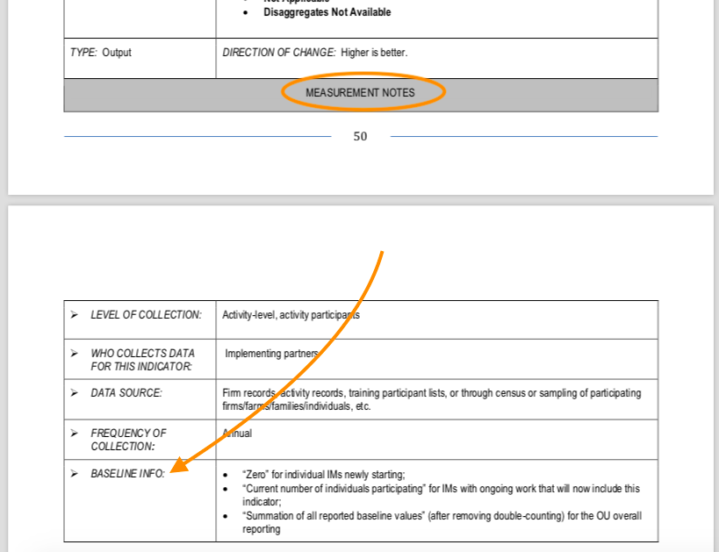
Tips & Reminders
View PIRS for baseline guidance on each
For output indicators: Baseline is always zero* *one exception is indicator EG.3-2 for ongoing IMs during transitions
For outcome indicators: Baseline is existing level prior to intervention

Slide 32
Tricky Indicators
Notes:
For IMs that don’t end before Oct 1, 2019, you will need to be setting targets as applicable, so it’s important you understand the definitions and how the data entry screens work.

Slide 33
Tricky Indicators!
EG.3-2 – # individuals participating
EG.3.2-24 – # individuals applying
EG.3.2-25 – # hectares under improved management
EG.3.2-26 – Value of annual sales
EG.3.2-27 – Value of agricultural financing
EG.3-10, -11, -12 – Yield at IM-level

Slide 34
EG.3-2 Number of individuals participating in USG food security programs [IM-level]

Slide 35
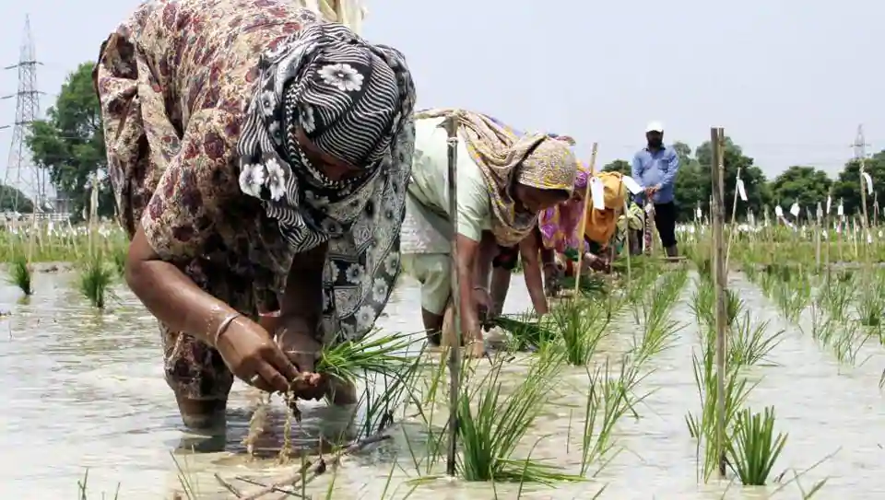
Tricky Indicators! EG.3-2 Number of Individuals Participating
Purpose is to capture breadth of our work –who do we reach?
Expands on FTF01, which counted only smallholder farmers
Enter all your direct participants by Sex, Age, Type

Slide 36
Tricky Indicators! EG.3-2 Number of Individuals Participating
Children <5 yrs reached with nutrition-specific interventions go under HL.9-1 instead (except those reached with school-feeding program *can* be counted here)
When working with households (HHs):
Activities working with multiple members of a HH, only count those who actually participate
For HH-level interventions (e.g. sanitation) – count all HH members
See PIRS for specific examples of who to count

Slide 37
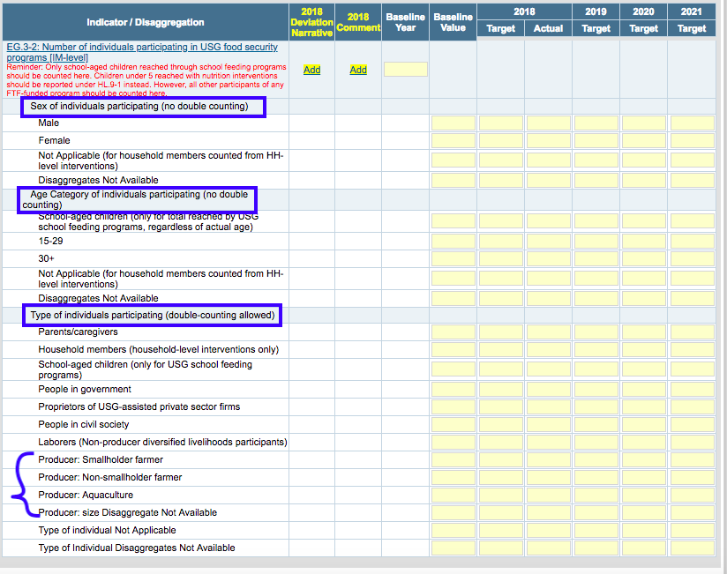

Slide 38
EG.3.2-24 Number of individuals in the agriculture system who have applied improved management practices or technologies with USG assistance [IM-level]

Slide 39
Tricky Indicators! EG.3.2-24 Number of Individuals Applying
Expands on EG.3.2-17 to include more individuals in value chain
If reporting individual producers in this indicator applying improved practices to hectares of land or water, then also report their hectares under indicator EG.3.2-25 (similar to connection between EG.3.2-17 and EG.3.2-18 last year)

Slide 40
Tricky Indicators! EG.3.2-24 Number of Individuals Applying
Report these individuals by: Sex / Age / Management Practice or Tech Type they’re applying / Commodity (if applicable) -->> Unique number in Sex & Age but double-counting allowed under Management Practice and under Commodity
Notes on double-counting:
If a farmer is applying one type of irrigation practice and two types of pest and disease management practices (e.g. aflasafe and pesticide ), she would be counted once under Irrigation and only once under Pest and Disease Management, i.e. double-count across disaggregate categories is ok, double-counting within categories is not.
Same thing with commodities. A farmer producing maize and soy target crops applying multiple practices in maize and practices in soy gets counted once under maize and once under soy.

Slide 41
Tricky Indicators! EG.3.2-24
No data cells? Must choose commodity first on “Select Indicators…” screen!

Slide 42
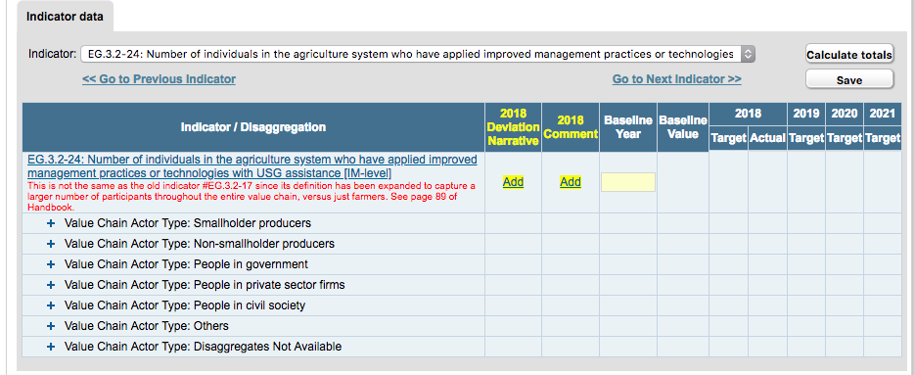
Tricky Indicators! EG.3.2-24

Slide 43
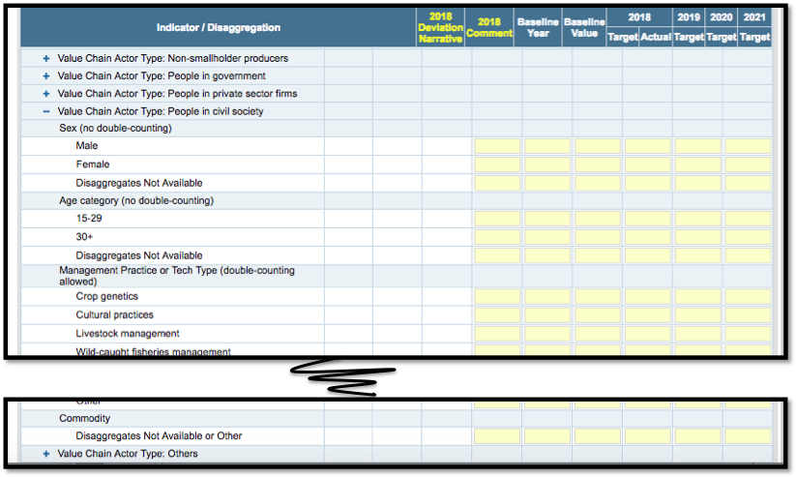

Slide 44
EG.3.2-25 Number of hectares under improved management practices or technologies with USG assistance [IM-level]

Slide 45
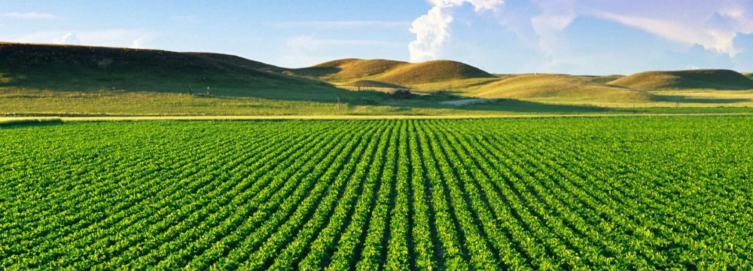
Tricky Indicators! EG.3.2-25 Number of hectares under…
Expands on EG.3.2-18 to include more types of hectares, including aquaculture and both intensive & extensive management practices
Remember individual producers of hectares reported here should be counted as “individuals applying” under EG.3.2-24! (similar to connection between EG.3.2-17 and EG.3.2-18 last year)

Slide 46
Tricky Indicators! EG.3.2-25 Number of hectares under…
Report these hectares by: Sex of Owner / Age of Owner / Management Practice or Tech Type being applied to them / Commodity -->> Unique number in Sex & Age but double-counting allowed under Management Practice and in Commodity
Notes on double-counting:
If a farmer is applying one type of irrigation practice and two types of pest and disease management practices (e.g. aflasafe and pesticide ), her hectares would be counted once under Irrigation and only once under Pest and Disease Management, i.e. double-count across disaggregate categories is ok, double-counting within categories is not.
Same thing with commodities. A farmer producing maize and soy target crops applying multiple practices in maize and practices in soy gets counted once under maize and once under soy.

Slide 47
Tricky Indicators! EG.3.2-25
No data cells? Must choose commodity first on “Select Indicators…” screen!

Slide 48
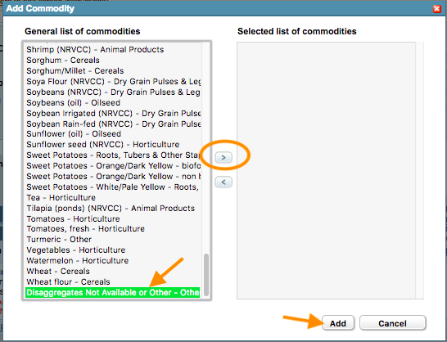
Tricky Indicators! EG.3.2-25
If not reporting on a commodity (e.g. under Conservation/protected area extensive hectare type), still have to choose one from Commodity List --> pick “Not Applicable” at bottom of list!
If disaggregating by commodity not meaningful or possible (e.g. multiple crops intermixed in the same plot or agroforestry with a number of different species) --> pick “Disaggregates not available” at the bottom of the list!

Slide 49
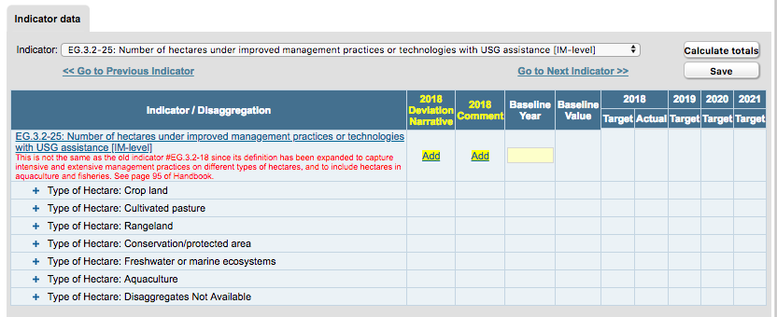
Tricky Indicators! EG.3.2-25

Slide 50
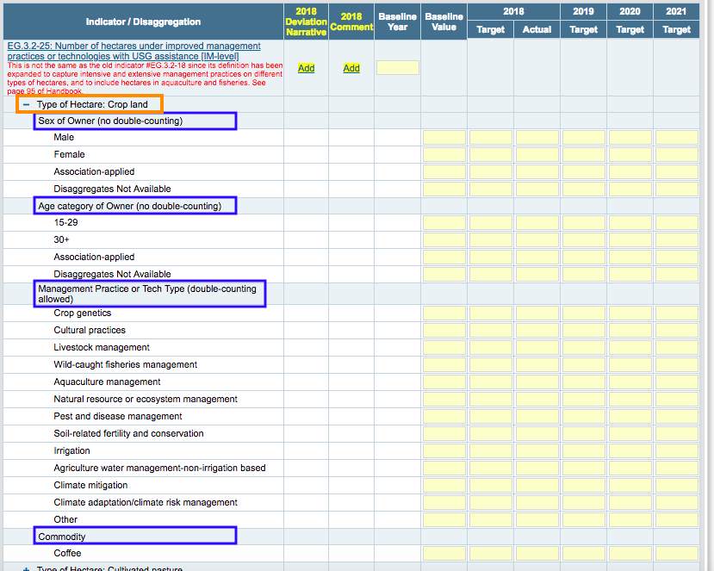

Slide 51
EG.3.2-26 Value of annual sales of farms and firms receiving USG assistance [IM-level]

Slide 52
Tricky Indicators! EG.3.2-26 Value of annual sales
This replaces EG.3.2-19 (Value of Incremental Sales “VIS”) and includes broader universe (+ firms!)
Steps for data entry:
[1]: If going to report on a commodity, choose it on the “Select Indicators & Commodities” screen;
[2]: Choose Type of Product / Commodity / Type of Service from menu
[3]: Choose Producer size or Firm size and expand section
[4]: Value $ / Number participants / Volume (for commodities) by Sex and Age Category

Slide 53
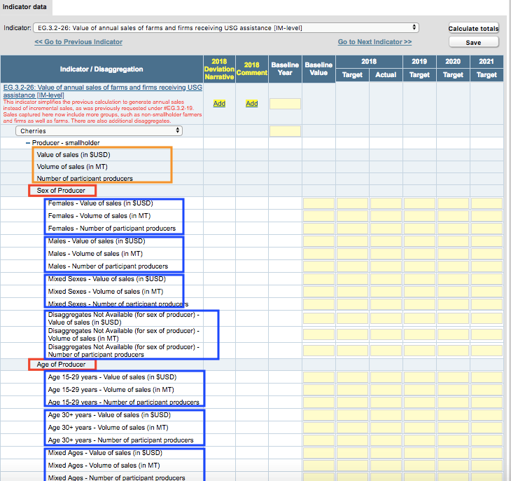

Slide 54
EG.3.2-27 Value of agriculture-related financing accessed as a result of USG assistance [IM-level]

Slide 55
Tricky Indicators! EG.3.2-27 Value of ag financing
This indicator now includes all types of financing (debt + non-debt) and expands on EG.3.2-3 (Number of micro, small, and medium enterprises (MSMEs), including farmers, receiving agricultural-related credit as a result of USG assistance) and EG.3.2-6 (Value of agricultural and rural loans as a result of USG assistance)
Type of financing accessed: Cash Debt; In-kind Debt; Non-Debt
Value of Financing by Recipient Size / Sex / Age
Number of Recipients by Recipient Size / Sex / Age
FTFMS will roll up totals on-screen

Slide 56
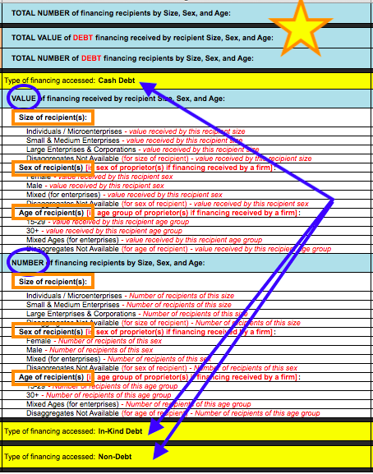

Slide 57
EG.3-10, -11, -12 Yield of targeted agricultural commodities among program participants with USG assistance [IM-level]

Slide 58
Tricky Indicators! EG.3-10, -11, -12 – Yield at IM-level
Yield = Total Production / Units of Production
Replaces Gross Margin (EG.3-6, -7, -8) with a simplified measure of agricultural productivity
Several data points used under Gross Margin are the same as in this yield indicator (TP, UP, # participant producers)

Slide 59
Tricky Indicators! EG.3-10, -11, -12 Yield at IM-level
Complicated because we:
Are collecting yield of many different commodities (e.g. bananas vs. cattle!)
Need to disaggregate by farm size vs. production system; and
Need to use different default units for each commodity group. [Note that “default units” refer to preferred UoM for TP and the required UoM for UP as listed in PIRS.]
Solution -->> Make yield “sub-indicators” for each group of commodities (eight total)

Slide 60
Tricky Indicators! EG.3-10, -11, -12
Crops: metric tons / hectare
disaggregated by farm size (smallholder vs. non-smallholder producer), then sex and age category

Slide 61
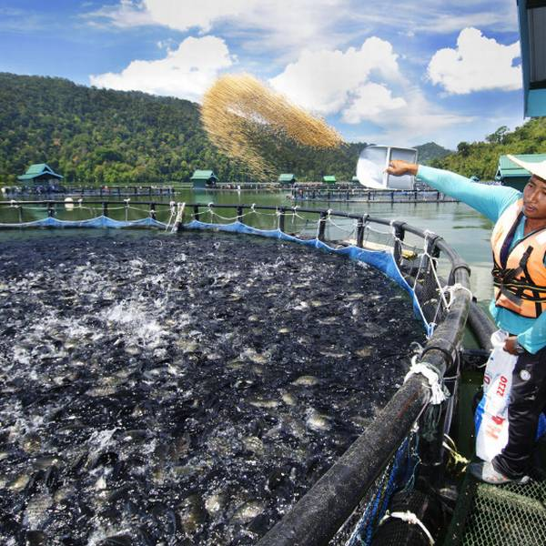
Tricky Indicators! EG.3-10, -11, -12
(2) Pond aquaculture: KGs / hectare of surface area;
(3) Cage aquaculture: KGs/ cubic meter of cage
These two have no farm size disaggregate, but still disaggregated by sex and age category

Slide 62
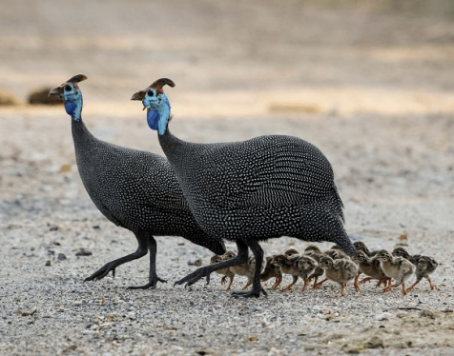
Tricky Indicators! EG.3-10, -11, -12
(4) Dairy: liters of milk / max number of producing animals during the reporting year
(5) Eggs: number of eggs / max number of producing hens during the reporting year
(6) Livestock: weight in KGs of offtake (entire animal(s)) / max number in herd / flock / other group during the reporting year
These three disaggregated by production system (Rangeland, Rural mixed livestock-crop, Urban/peri-urban, and Intensive, commercial), then sex and age category

Slide 63
Tricky Indicators! EG.3-10, -11, -12
If you can't enter data using the default units listed, choose one of these two instead:
(7) "Other Yield – you choose units – disaggregated by farm size” [Crops]
(8) "Other Yield – you choose units – disaggregated by production system” [Animals / Animal Products]

Slide 64
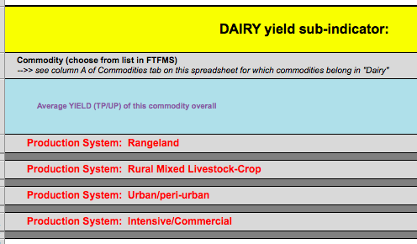
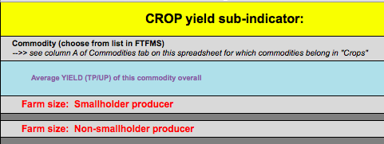

Slide 65
Tricky Indicators! EG.3-10, -11, -12
Steps for data entry:
(1) Choose commodity(ies) on “Select Indicators & Commodities” screen
(2) Choose appropriate yield sub-indicator
Crops
Pond aquaculture
Cage aquaculture
Dairy
Eggs
Livestock
Other – by Farm Size [Crops]
Other – by Production System [Animals / Animal Products]
(3) Enter Number of Participants, Total Production, and Units of Production -->> Each by Sex and Age Category!
(4) Check FTFMS automatically-calculated yield totals at top

Slide 66
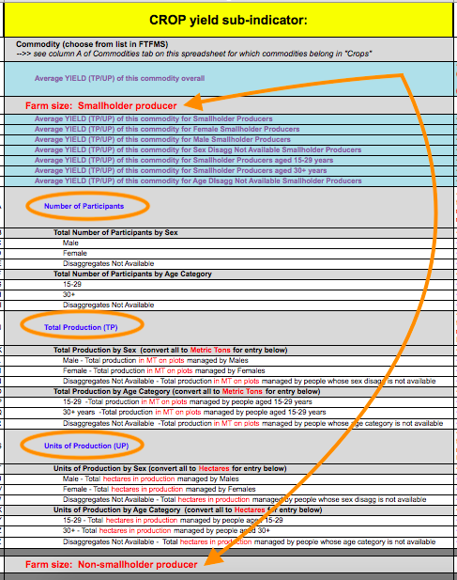

Slide 67
Resources
KEY LINKS:
FTF Resources Page (https://agrilinks.org/ftfms)
FTF Indicator Handbook NEW!! Published March 2018
FY18 FTFMS Webinar event page (recording will be posted here later)
MEL Toolbox (multiple resources!)
FTFMS website / FTFMS Training website
NEED HELP or an FTFMS ACCOUNT?
Contact the HelpDesk at support@ftfms.net
FORGOT YOUR PASSWORD?
Click "Forgot password" at the bottom left of the FTFMS log in screen
NEED PRACTICE?
Visit the FTFMS Training Site (just add "TRN_" before username; same pw)

Slide 68
Feed the Future MEL Webinar Series
Intro to the MEL System
Standard Indicator Overview
New Indicators: Application of improved practices and technologies
New Indicators: Sales, finance, and investment
FY18 FTFMS Reporting (today!)
Geocoding feature in FTFMS (pre-recorded mini-webinar)
Nutrition, Sanitation & Hygiene Indicators (Oct 11)
New Indicators: Gender (Oct 17)
Reporting on Policy Change (Oct 30)
New Indicators: Yield and agroecological
Feed the Future Learning Agenda
Notes:
Here’s a list of the upcoming MEL webinars in this series. The full schedule is available online here: https://www.agrilinks.org/post/feed-the-future-mel-webinar-series

Slide 69
Questions later?
System or account questions? =
Support@ftfms.net (it’s Mike at our Help Desk!)
Technical or indicator questions? =
If you’re an IP --> contact your Mission or USAID POC
If you’re a USAID Mission --> contact your BFS MEL TA
If you’re in the Interagency --> contact Katie West

Slide 70
Q&A

