Slide 1
LEVERAGING ‘BIG DATA’ FOR WHEAT IMPROVEMENT IN KANSAS AND AROUND THE WORLD
JESSE POLAND
Kansas State University
Feed the Future Innovation Lab for Applied Wheat Genomics

Slide 2
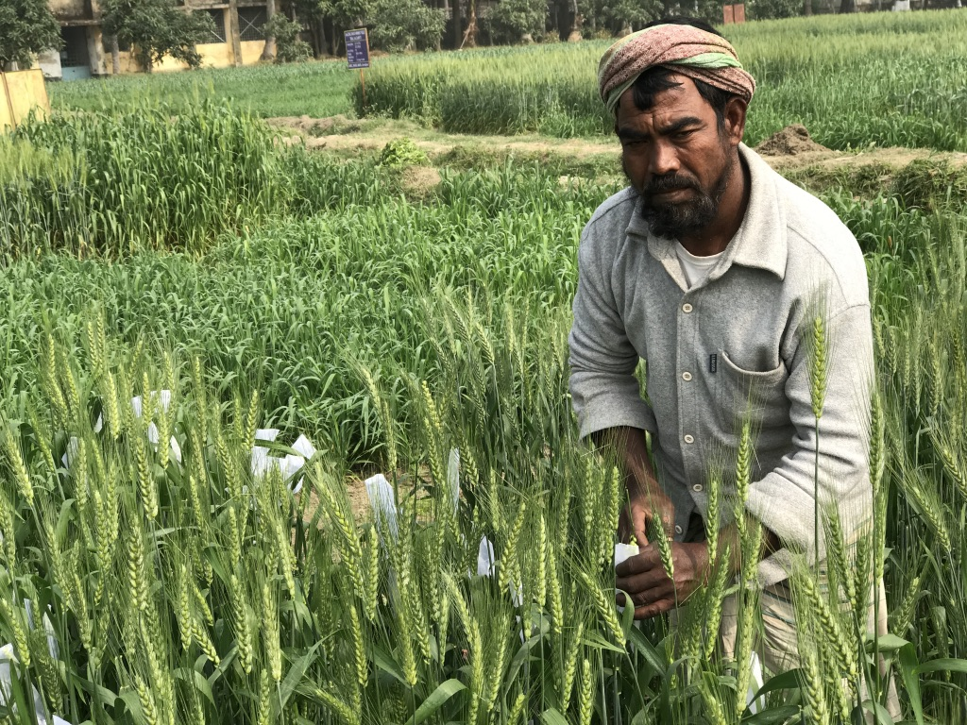
60%
Increase in demand for wheat by 2050
- 20%
Potential average yield loss from climate change
>2%
Rate of gain needed to meet projections
~ 1%
Current rate of gain

Slide 3
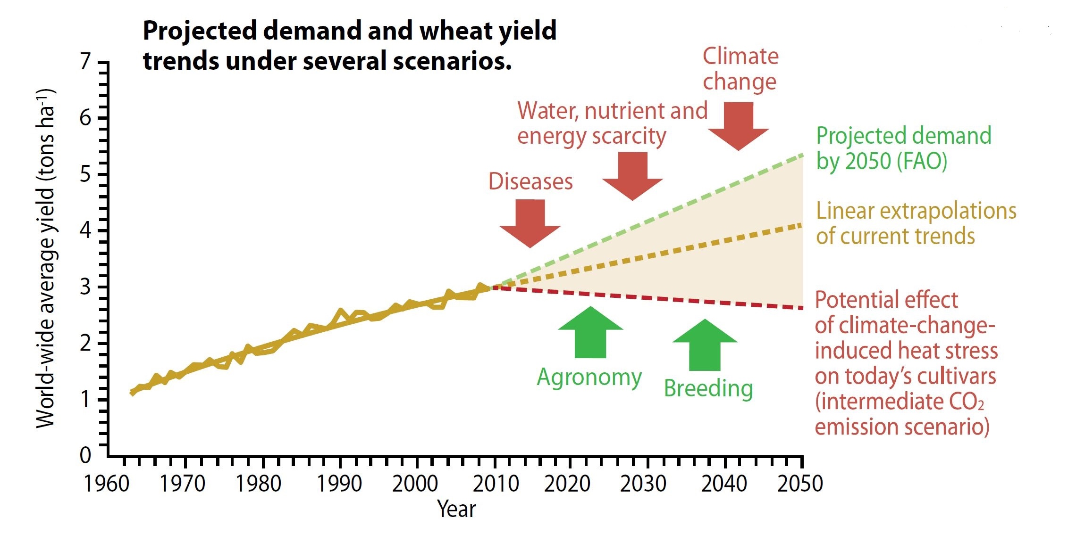
CIMMYT 2014

Slide 4
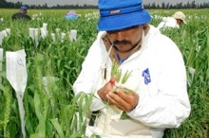

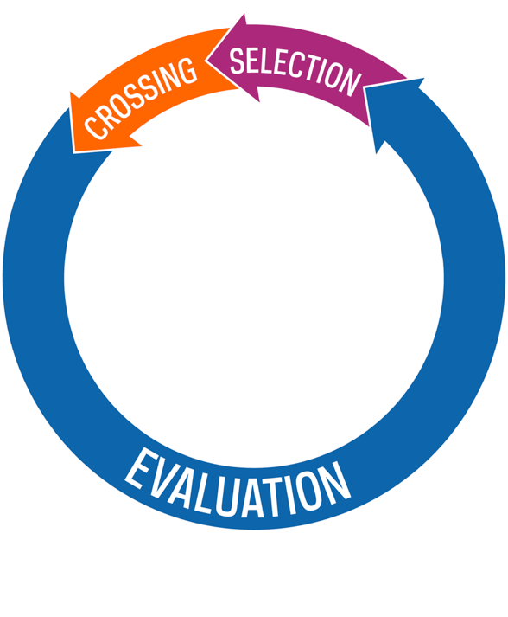
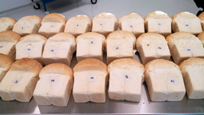
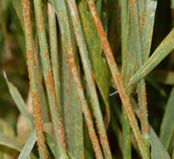
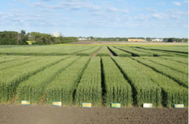
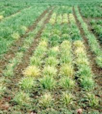
THE BREEDING CYCLE
genetic gain
year on year progress in overall performance of breeding lines

Slide 5
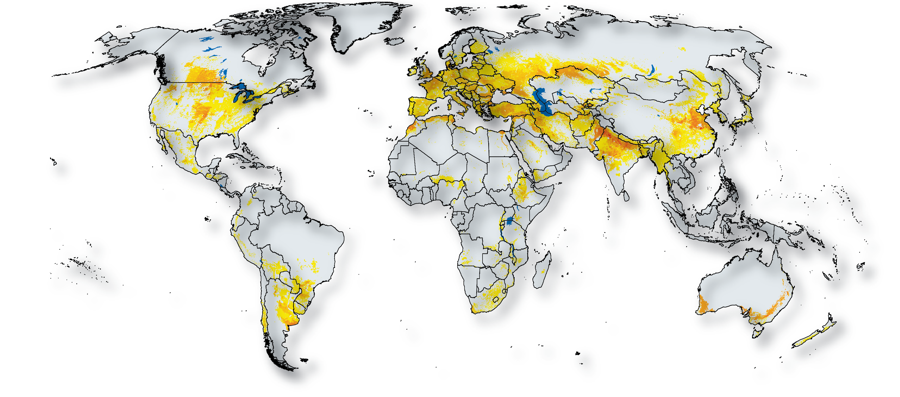
Source: CIMMYT / IFPRI

Slide 6
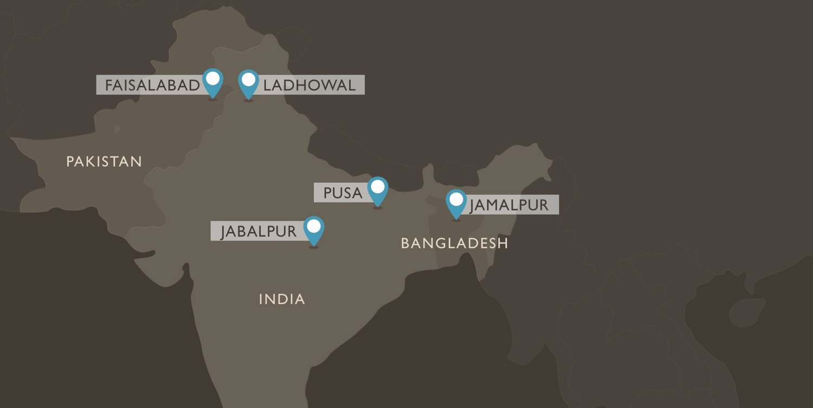


Focus is in South Asia, where over 20% over the world’s wheat crop is produced. These extreme heat environments are highly vulnerable to the impacts of global climate change.
International partners

Slide 7
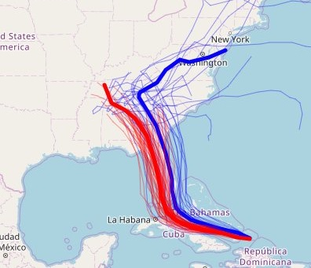
PREDICTION MODELS
billions of data points
wind speeds
sea temperatures
mathematical equations of physical process
algorithms modeling the atmosphere at every point on the globe
super computer to simulate possible outcomes

Slide 8
PREDICTION MODELS
billions of data points -
yield and baking measurements -
genomic information / sequence variants -
mathematical equations of genetics -
algorithms to calculate all of genetic effects -
processed on super computer to solve models

Slide 9
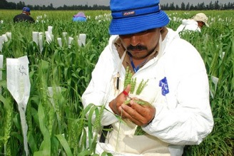
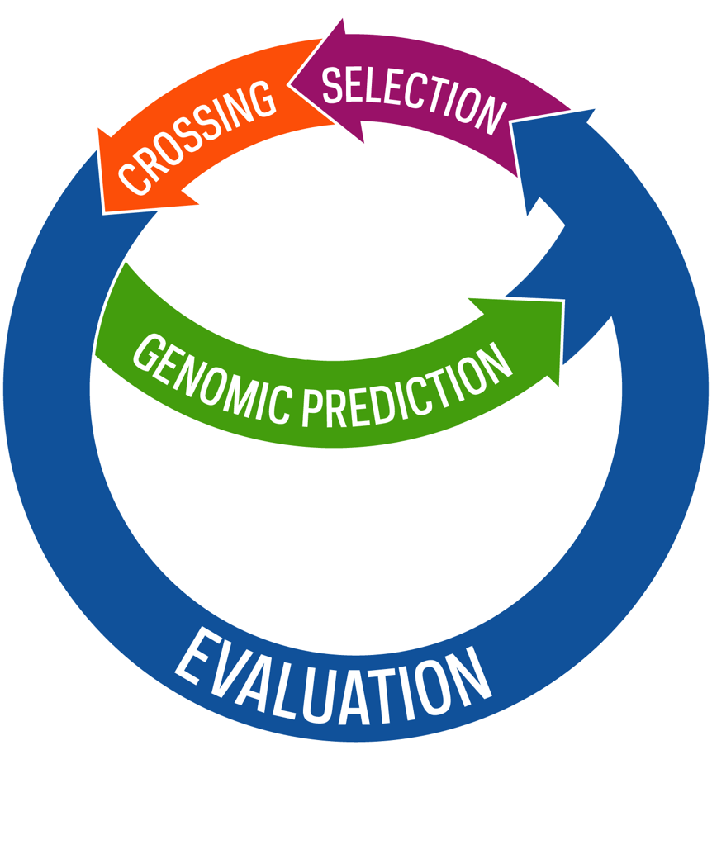
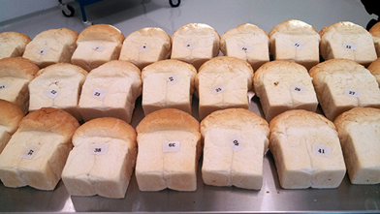
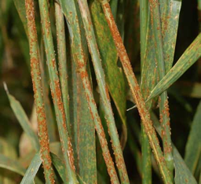
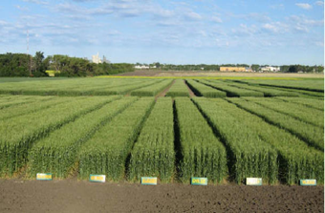
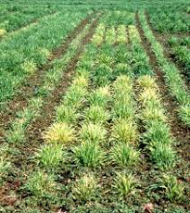
ACCELERATINGTHE BREEDING CYCLE

Slide 10
BIG DATA
data sets that are so large or complex that traditional data processing application software is inadequate to deal with them
data driven modeling approaches ….
‘the more data, the better’
The GOOD… we can predict about anything
The BAD… big challenges in modeling
The UGLY… big data is messy and hard to manage
Prediction Accuracy
Battenfield, S. et al. (2016) The Plant Genome. DOI: 10.3835/plantgenome2016.01.0005
www.en.wikipedia.org/wiki/Big_data

Slide 11
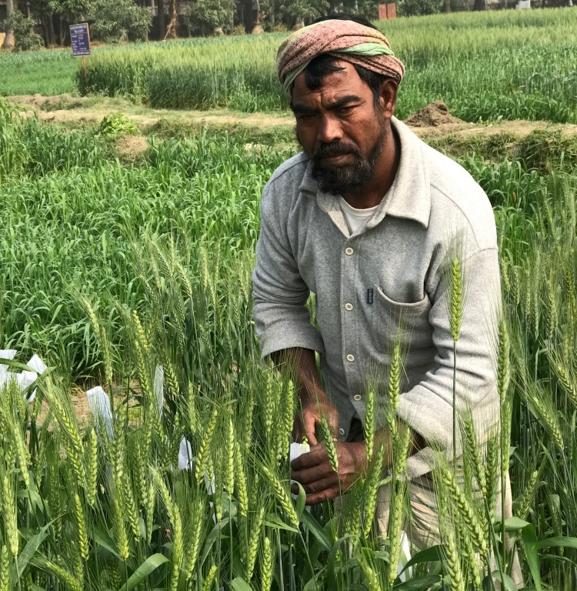





Photo: Kansas Wheat

