Slide 1
Feed the Future MEL Webinar Series: Standard Indicator Overview
May 22, 2018
Notes:
Welcome to another webinar in the Spring MEL Webinar Series. Today we are discussing the “Standard Indicator Overview”.

Slide 2
Presenters
Anne Swindale
Madeleine Gauthier
Kristy Cook
Tyrell Kahan
Jessica Bagdonis
Janina Mera
Alexandria Schmall
Katie West
Katie West
Julie MacCartee
Notes:
I’m the host, Julie MacCartee, and our main speaker today will be Katie West, the FTFMS System Administrator and manager of the performance reporting process for the Feed the Future (FTF) Initiative. She is a member of the MEL team in BFS HQ in Washington.
We also have a suite of colleagues from a variety of offices within BFS HQ here with us today to give brief overviews on indicators in their area of expertise. Their names are listed at the right of the slide, and we’ll get to those specific indicator overviews towards the end of the presentation.
I’ll now turn it over to Katie West to get us started.

Slide 3
Agenda
Introduction
Notable Changes
Publication of New Handbook
Transition to New Indicators
Overviews of Specific Indicators
Q&A
Notes:
Katie to discuss agenda for the day.

Slide 4
Introduction
Indicator transition (new handbook March 2018)
What are indicators?
Measures that enable us to monitor performance;
Support phase two of the USG’s FTF initiative, guided by the Global Food Security Strategy (GFSS);
Assess progress against each result in Result Framework;
Monitor the causal flow from outputs --> project outcomes --> population/system-level outcomes --> impacts;
Assess plausibility
Notes:
As you’ve seen in our announcements, we have spent the last year developing a new set of standard indicators, which support phase two of the USG’s Feed the Future Initiative under the Global Food Security Strategy (GFSS). This process involved two public surveys, consistent interagency coordination, and input from a variety of stakeholders to land on the best final set. Our last handbook update was published in July 2016 and this new one just came out in March 2018. We will discuss details of the transition later in this presentation.
And just to make sure we’re all on the same page and using the same language, “indicators” are measures that enable us to monitor and manage the performance of the Feed the Future Initiative and are designed to measure progress against each result in the Feed the Future results framework, which I’ll show an image of in the next slide.

Slide 5
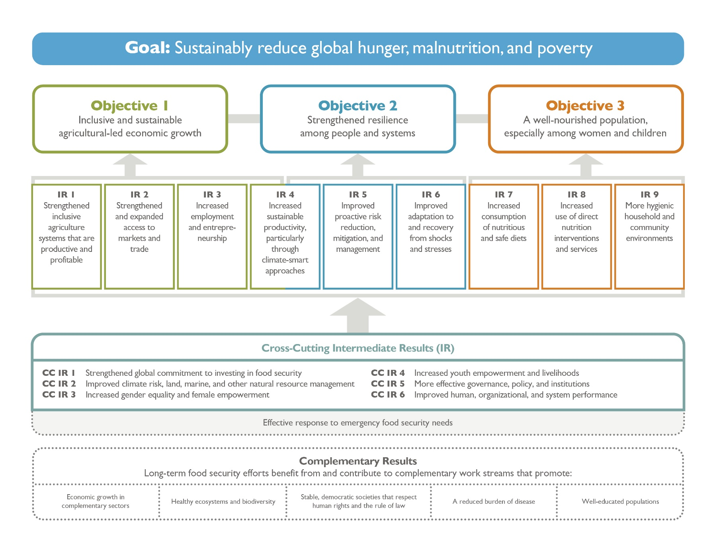
New Results Framework
Notes:
This results framework has indicators identified at each level, which helps us monitor the causal flow from outputs to project outcomes to population - or system-level -outcomes to impacts. This helps us logically assess the plausible contribution of our actions to the achievement of our impact.
At the goal level, we will measure hunger, malnutrition, and poverty among the population in Feed the Future target countries and in the Zone of Influence (ZOI). The ZOI is where our programming intends to achieve the greatest household-and individual -level impacts on poverty, hunger, and malnutrition and for which we hold ourselves accountable.
At lower levels of the results framework, indicators measure results at the national or ZOI population level, agriculture and food system level, and among project participants and this is where our partners need to focus.
While they are definitely very important, standard indicators are only one part of our MEL system. They are meant to be capture some of the most important aspects of the work we do across the results framework. But monitoring indicators can only tell us so much in the absence of good custom indicators, good evaluations, and most importantly, analyzing the using the data.

Slide 6
Striking a balance
Adequate measurement of the large results framework
Reporting burden
Total number of IM performance indicators are similar
Notes:
Our goal going into this process was to strike a balance between measuring all facets of the results framework adequately while keeping the reporting burden manageable.
This was made tough by the fact that under the GFSS, our results framework went from two objectives to three and eight intermediate results to 15.
The total number of performance indicators only increased from 53 to 54, and “implementing mechanism” indicators went down, from 28 to 27.

Slide 7
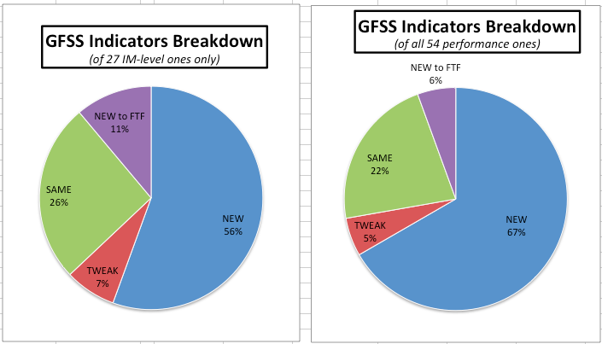
Notable Changes
Indicators are a mix of continuing, new, revised, and adopted from other sectors
Notes:
The indicators published in our new handbook are a mix of continuing, new, revised/tweaked, and adopted from other sectors. You can see the breakdown in the pie charts below, with the chart on the right representing all 54 performance indicators, and the chart on the left representing the breakdown within the 27 IM-level indicators only. Note that a few are just “New to FTF”, meaning they have been standard indicators in other sectors that we are now adopting this year as part of the FTF measures. For USAID Mission staff, you’ll recognize these as “F standard indicators”, but we are adopting them this year as part of the FTF measures. All of these changes to the set of indicators are outlined in detail in Appendix 2 of the Handbook, which we’ll discuss later.
One important point on this though is that while some of the indicators look like they are the same, we consider them new if there have been sufficient changes to the definition so that we will not be able to compare what we measured under the old indicator to what we are measuring under the new indicators. One example is the “# of hectares under improved technologies…” indicator, which now captures improved management practices at a more extensive scale such as watershed. Be sure to attend the webinar specifically on the new application of improved practices indicators to learn more – we have the dates posted on the first slide!

Slide 8
Performance vs. Context
PERFORMANCE:
Results for which OUs are held accountable
Required to set annual or multi-year targets
Belong in four categories, based on the level at which data for the indicator are collected:
(1) IM-level [27 of 54]
(2) ZOI-level [20 of 54]
(3) National-level [6 of 54]
(4) Multi-level [1 of 54]
Notes:
The list includes two types of indicators: performance indicators and new context indicators.
All of the indicators are grouped into categories based on the level of the measure, i.e. IM-level versus ZOI-level, National-level, and one multi-level one. You can see the distribution of these categories in the pie chart at the right (for the performance indicators) and the green box on the left (for the context indicators).
Performance indicators are the ones you’re familiar with where you are held accountable for reporting annual results and also setting multi-year targets. We have 54 of these in our new set, and 27 of them are at the IM-level, meaning these are the ones that monitor progress and results of specific IMs and represent results among the people and organizations who participate in the project’s interventions.
IM-level indicators are collected by IPs and reported annually across all Feed the Future countries regardless of whether they are target countries or aligned. IMs should report on these indicators if you are expected to produce results measured by that indicator.
All IM-level indicators should only report results achieved in that reporting year; they are not reported cumulatively (i.e. you should not add in the previous year’s results into the current year’s results). However, you can and should report this year’s results for a participant for whom you reported results last year if that person or organization continues to participate in the activity in the current year.
Of the 54 performance indicators, there are 20 ZOI-level indicators, which measure progress across the Zone of Influence (or targeted geographic area where we want to focus our efforts) and are collected through a population-based survey. Six are national-level, meaning measuring a result representative of the whole country, and one on institutional architecture is multi-level, which we’ll go over in bit more detail later in this webinar.

Slide 9
Performance vs. Context
CONTEXT:
Used to interpret performance results;
Not held accountable for changes -- no targets set;
Only required for target countries, but encouraged for aligned countries;
No need to collect primary data – report as secondary data becomes available
Belong in four categories based on the level of collection:
(1) Global-level [1 of 25]
(2) National –level [17 of 25]
(3) ZOI-level [5 of 25]
(4) Recurrent-crisis area [2 of 25]
25 Context indicators
1 Global-level
17 National-level
5 ZOI-level
2 recurrent crisis areas
(if available; Otherwise national)
Notes:
Context indicators are new this year, but help us monitor important aspects of our working environments / country contexts that can inform our programming or understanding. These are things we’ll observe/monitor, but not conduct primary data collection for (we’ll use existing sources instead!), and we also will not hold ourselves accountable for their results, nor set targets for them. As an example, we’re planning to monitor rainfall in some of our ZOIs, but you can understand that it would not make sense to set a target for rainfall nor hold ourselves accountable for how much rainfall an area receives (although I’m sure we often wish we could influence this!).
While having both types of indicators at varying levels might seem confusing, note that the numbering of this set of 54 performance indicators and 25 context indicators is very clear so you can easily see if one is context (has “context” in the numbering scheme) versus performance, as well as see which level it’s to be measured at (i.e. has “IM-level” or “ZOI-level”, etc. as part of the official indicator title).
We’ll focus more on the performance indicators here in this webinar.

Slide 10
Performance Indicators: Standard vs. Custom
Standard:
IMs and OUs held accountable for results
All are required-as-applicable (RAA) to ensure consistency of reporting and meaningful aggregation of results:
all OUs receiving Feed the Future funding are required to report on all indicators at the (IR) or (CCIR) level to which a Feed the Future-funded project contributes results
if an OU expects a project to generate results that are measured by the indicator, the OU must establish a baseline, set targets, and report results for the indicator.
Notes:
The 54 performance indicators are all standard, meaning they have a set definition we all use (the PIRS in the Handbook, which stands for Performance Indicator Reference Sheet), and are reported in the same way by all activities who use it, and is collected centrally.
Activities/IMs and Operating Units (OUs) are held accountable for results, and must set targets, collect data (with a few exceptions to be described later), and report results annually into our centrally-managed monitoring database, called the Feed the Future Monitoring System, or FTFMS.
Standard performance indicators are “required-as-applicable”, which in simple terms means that if you are working in an area covered by the indicator, you must report against it, so we are sure to have comprehensive results across the initiative. More specifically, if you receive FTF funding, you must report on any indicator at the IR- and CCIR-level of the Results Framework that measures a result that your activity produces.
For example, if your activity is working to increase access to financial services, you must report on indicator “EG.3.2-27 Value of agriculture-related financing accessed as a result of USG assistance”. However, if your activity is not doing anything related to financial inclusion, you clearly would not be required to report against this indicator.
All indicators at the goal and Objective level of the Results Framework are required for target countries.
Since outcome and impact indicators measure conditions that existed in among our target participants and populations before each project or activity started, baseline information is required for all of these indicators, to better allow us to tease out the changes in these conditions that are related to our work. With one exception, which we will cover later in the presentation, baselines for output indicators, which measure results directly produced by an activity, are set to 0, since an activity cannot produce results before it starts.

Slide 11
Performance Indicators: Standard vs. Custom
Custom:
Use in addition to standard!
Needed because standard ones often insufficient to monitor progress along every project’s or activity’s logic model;
Can support learning and adaptation at an OU or IM level;
Notes:
We want to be clear that while we collect the standard indicators centrally and use them to report on important progress of our Initiative, these are most likely insufficient to monitor progress along every project’s or activity’s logic model, and therefore custom indicators are needed. These should be in addition to any standard ones you’re required to report on, and be tailored to tracking progress specific to your project. Custom indicators can also be a critical component to support learning and adapting in your work. At this point, FTFMS is unable to systematically collect custom indicators (you are only able to upload excel files of them), but we are working on possible ways to improve that.

Slide 12
Performance Indicators: Standard vs. Custom
Options for custom indicators:
Develop them;
Use ZOI-level ones at an IM-level;
Use archived FTF standard indicators (will remain in FTFMS!)
Add custom disaggregates to standard indicators
Use suggestions from sector experts, e.g. forthcoming market systems guidance
Notes:
Where do custom indicators come from? Implementing Partners (IPs) and OUs can collaborate to develop them directly, or you could take an existing ZOI-level one but apply it as custom at an IM-level. Old FTF standard indicators that we are archiving/dropping from central collection will still remain available in FTFMS and could be used as custom indicators if appropriate for your activity. You might also consider simply adding a custom disaggregate to a standard FTF indicator, for tracking progress specific to your activity.
For example, adding a custom disaggregate that allows you to track results by district could be very useful for performance management. Lastly, you could look for suggested custom indicators from sector experts, such as our forthcoming market systems guidance (for which there is a separate webinar scheduled to discuss this soon).

Slide 13
Indicator/PIRS-specific Changes
People-level indicators disaggregated by sex and age
Indicators in general have a greater focus on capturing changes throughout the value chain, including private sector partners, market participants, etc.
Reporting notes for the more complicated indicators include examples for FTFMS data entry in PIRS
Notes:
Just a bit more detail on the indicator definitions under Phase two.
I also wanted to note that the language has changed as well from direct beneficiary to participant. We changed from using the term activity “direct beneficiaries” to using the term activity “participants” to describe the universe captured by IM-level indicators to better align with market system-based approaches. The revised terminology also more clearly communicates that those with whom we work are active participants in their country’s development journey, for their own and others’ benefit.
Indicators, as part of the title, include the reporting level (National, ZOI, IM)

Slide 14
Handbook of Feed the Future Indicator Definitions
Notes:
Now let’s look at the new handbook specifically.

Slide 15
Where to find them
“Old” (current) FTF Indicator Handbook (published July 2016) = https://www.agrilinks.org/library/feed-future-handbook-indicator-definitions
New FTF Indicator Handbook (published March 2018) = https://www.agrilinks.org/post/feed-future-indicator-handbook
Notes:
This slide has the links to the online versions of both the old and new handbook for your reference.

Slide 16
New Handbook landing page:
Notes:
This is what the website landing page looks like for the new Handbook, and I just want to point out the links at the right-hand side of the page. This is where you can find both PDF and Word versions of the new Handbook, as well as a link to the Results Framework, and a nice summary Excel chart of all the new indicators and their disaggregates. Please share this website widely.

Slide 17
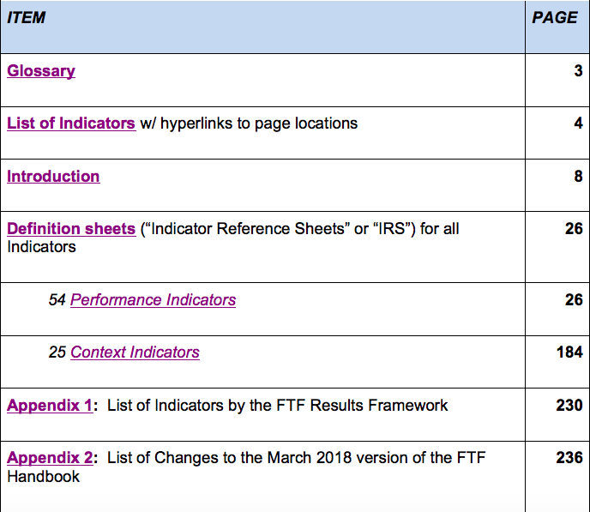
Using the Handbook
Notes:
Once you open the Handbook, you’ll see a Table of Contents with hyperlinks at the beginning, so you can easily navigate the large document. You’ll see it starts with a glossary of terms and then a chart listing all the indicators, followed by an informative introduction, and then it gets into the individuals definition sheets or “IRS” (Indicator Reference Sheets) for each of our 54 performance indicators and 25 context indicators. The end of the Handbook has two appendices – one that shows where all the indicators are associated to the Results Framework, and a second appendix that goes into detail about all the indicator changes.
I highly recommend all IPs and OUs read the Introduction, even if you are already familiar with FTF, since it provides critical information on our performance monitoring and the changes under FTF Phase Two. I also would recommend reading Appendix 2 so you can more easily understand the changes as compared to the last Handbook from July 2016.

Slide 18
Appendix 2 – important!
Lists changes since last handbook (July 2016)
New!
New to FTF
Minor changes
Archived/Dropped
Notes:
Appendix Two goes into detail about each of the types of indicator changes reflected in this new Handbook – please take the time to look it over, and keep it handy for reference.

Slide 19
Transition & Rollout
Notes:
Now let’s discuss the transition to using this new set of indicators.

Slide 20
Transition & Rollout
Activity-level indicators:
- Activities end before Oct 2019: New indicators optional
- Activities end after Sep 2019: New indicators mandatory
Reporting in FTFMS:
- Fall 2018: set targets new indicators for FY19-21, report on results for new indicators if fully aligned with definition, otherwise report on old indicators
- Fall 2019: report against new indicators for FY 2019
Notes:
In general, activities that end before October 2019 are not required to switch to the new indicators, but are encouraged to do so if desired. Activities that end after Sept 2019 are required to transition to the new set.
As you know, we report data at the end of the fiscal year into our monitoring system, FTFMS, which means data entry occurs every fall.
For this fall of 2018 (where we will be reporting results that occurred in FY2018 and three out-year targets), you should report results achieved for new indicators only if they are fully aligned with the indicator definition as written in this new Handbook; Otherwise, report on the old indicators.
For activities continuing beyond Sept 2019, three out-year targets (FY19-21) should also be entered for the new indicators in FTFMS.
Then in the following year (Fall of 2019, when we will be reporting results achieved during FY2019 and the out-year targets of FY20-22), everyone who’s required should report on the new indicators.
In summary:
---If IMs or OUs have FY18 results to report for any of the new indicators in October 2018, they are highly encouraged to do so, as long of the results being reported fully align with the new indicator definitions.
---
For indicators that are revised from phase one as opposed to completely new, IMs or OUs should only report on one version of the indicator in any given year to avoid double-counting, and should only report on the revised indicator or disaggregate if reporting fully aligns with the definition.

Slide 21
Notes:
Here is chart showing exactly what to do during this fall and next fall for reporting in FTFMS, based on the time left in your project. I recommend printing this out and keeping as a handy reference during this transition period. We have posted this as a resource document in the “links” pod box of this webinar for easy printing.

Slide 22
Transition & Rollout continued….
• ZOI indicators:
- New indicator baselines - 12 target country FTF 2.0 ZOIs - 2018-19
• National and context indicators: Report as soon as data are available
• Webinar series (like this!) for rollout
• Revisions to handbook next year, then only as needed
Notes:
We will have a separate webinar to discuss ZOI-level indicators, but I just want to briefly mention that the baselines for these ZOI-level indicators (which are often collected in a population-based survey, or “PBS”) should be collected for the 12 target countries during 2018-2019.
National-level and context indicators can be reported as soon as data are available.
Our roll-out of these new indicators started with the announcement and publication of the new handbook in March, and then hosting a series of MEL-related webinars this Spring (like this one!), so be sure to attend them so you’re up to date on all the MEL-related changes and topics under FTF Phase Two.
We recognize that there may be changes needed to the handbook next year, after the first year of implementation, since sometimes problems are discovered or issues arise once people begin reporting on them. After any necessary revisions to ensure it’s the best set of measures to track FTF performance, we are not planning to continually revamp the Handbook. Ideally, these measures will be in place for long enough to track trends from results reporting under the same definitions / nuances. Of course, some changes may be necessary, but a full revamp is not planned at this time.

Slide 23
Q&A
Notes:
We’ll pause here for a quick question and answer time about what we’ve gone over so far. After this, we will go into short overviews of some of the new indicators, but first, are there any questions about what we’ve gone over so far, or about the Handbook in general?

Slide 24
Overview of Specific Indicators
Notes:
Now we’d like to give some very brief overviews of some of the newer indicators in this Handbook. Note that many of the more complex or nuanced indicators will have their own whole webinar to further explain / discuss them, so the ones we’re highlighting here are new, but more simple, and only require a brief highlight, which we’ll do here.

Slide 25
We’ll Discuss These:
Number of Initiative participants – ANNE SWINDALE
"Ag GDP+” – MADELEINE GAUTHIER
Employment – MADELEINE GAUTHIER
Institutional Architecture – KRISTY COOK
Research – TYRELL KAHAN
Org performance – JESSICA BAGDONIS
Land tenure – JANINA MERA
Resilience – JANINA MERA
Youth - ALEXANDRIA SCHMALL
Notes:
Here’s a list of the indicators we’ll go over today, and the BFS colleague who will be discussing it.

Slide 26
Number of individuals participating
Anne Swindale

Slide 27
EG.3-2 Number of individuals participating in USG food security programs [IM-level]
Captures breadth of FTF reach - - counts all project participants:
reached directly
through a deliberate service delivery strategy (not spillover)
participating in the markets we strengthen
People, not contacts!
Count once under Sex and Age disaggregates, more than once under Type of Individual
Firm proprietors, not all employees
Producers who buy or sell to assisted firms
Not non-producer customers or suppliers
Notes:
Hello everyone. It’s nice as always to be speaking with you. We’ll start this section of the webinar with how we’ll be counting the # of individuals participating in the Feed the Future initiative, under indicator EG.3 dash 2. This is a new indicator that expands on our previous collection of just smallholders or households benefitting. The indicator is much broader and aims to capture all individual participants with whom we work (with some exceptions which I’ll get to in a sec.). What hasn’t changed is that you should still count people only if they have received a significant service or good through their participation in the project, not just had brief exposure to something the project is doing. Significant means that you can reasonably expect to be held accountable for changes in that individual, and report on him or her under any applicable indicator of behavior change or other outcome.
The indicator captures those reached directly by project staff or project partner staff, as well as those reached by a deliberate service delivery strategy such as cascade training / Train-the-trainer, lead farmers etc. It also captures a subset of those who participate in markets we strengthen (I’ll say more on that in a bit.)
Some important things to remember:
Count people, not number of contacts, for example, not the number of training sessions participated in or the number of care group mother home visits received. You should count people only once under the sex and age disaggregates, but you can count them as many times as applicable under the type of individual disaggregate - for example a SHF who purchases inputs from an FTF-assisted supplier and participates in an FTF-supported care group with her 1 year old should be counted under each of the relevant type of individual disaggregate categories.
When working with firms, count the proprietor or proprietors of the firm, but not all the firm’s employees. Similarly for organizations, count the organization’s leadership, not all the organization’s employees.
In addition to the firm’s proprietors, you should also count the producers who are suppliers to or customers of that FTF-assisted firm or enterprise but, to reduce your reporting burden, you are not required to track and count all of the firm’s customers or suppliers. We are prioritizing producers because they are such a key target population in our theory of change.

Slide 28
EG.3-2 Number of individuals participating in USG food security programs [IM-level] (cont.)
All household members ONLY IF:
Improved sanitation services
Family-sized rations
DON’T count children under 5 or under 2 --> Count under HL.9-1/9-2
DO count kids participating in FTF school feeding programs
Report at IM and OU level
Notes:
Only count the individual members of a HH that participate in the project, not all the HH members even if the whole HH benefits from the individual’s participation, for example through increased production or income. The exception is in the case of sanitation facilities and family-sized rations which are targeted at households and thus all of the members of the household can be counted.
Kids under 5 reached with nutrition-specific interventions and kids under 2 reached with community-level nutrition programs should not be counted under this indicator – they need only to be counted under the indicators designed to count them, i.e. HL.9 dash 1 for kids under 5, HL.9 dash 2 for kids under 2.
Note that kids reached through school feeding programs, such as USDA’s McGovern-Dole, should be counted here (most of them are not under 5 anyway), and we have a specific disaggregate for them.
One unique thing about this indicator is that it should be reported at both the IM level and the operating unit (OU) level – the OU should report the unique number of participants across all of their projects, eliminating double-counting. There is some nuance with setting the baseline for the indicator, too, so be sure to read that information under Reporting Notes in the PIRS.
And now I’ll hand it over to Madeleine.

Slide 29
AgGDP+
Madeleine Gauthier

Slide 30
EG.3-e Percent change in value-added in the agri-food system (Ag GDP+) [National-level]
National level indicator added to:
capture changes in the agriculture-related value-added generated beyond agricultural production (Ag GDP)
Track the impact pathway of our investments in market system approach
Requires a Social Accounting Matrix (SAM) and various country-wide datasets
IFPRI through a BFS mechanism will generate baseline and annual estimates
Missions can use the estimates for planning and programming purposes. IFPRI will produce a write-up describing the model and assumptions and provide the necessary support to generate the targets
Ag GDP+ is a required performance indicator!
Notes:
This is a new indicator, which loosely replaces the Ag GDP indicator that was reported under the first phase of Feed the Future.
This is a national-level indicator developed by IFPRI to capture changes in all agriculture-related value-added.
The rationale for this indicator is that agricultural transformation should lead to increasing the share of downstream sectors, such as agricultural processing, but also of other production and services sector linked to the agricultural economy.
As we intensify our investments in market systems approach, our impact pathways should diversify and expand beyond agricultural production and productivity.
The indicator, Ag GDP+, captures the changes in the value-added generated by the entire agri-food sector.
The Agri-Food sector is composed of 5 components:
--Agricultural production itself (Ag GDP);
--Agricultural processing;
--The portion of trade and transport value-added associated with agriculture and agricultural processed products;
--The portion of intermediate inputs value-added used in agriculture and ag processing; and
--The portion of hotel and catering value-added associated with meals prepared and purchased outside of the household.
To calculate value-added generated from these 5 components, we need a social accounting matrix, better known as SAM.
A SAM is an economy-wide framework with different components linked to each other as flows of funds between economic actors. It is based on double-entry accounting principles (where expenditures = receipts).
Different datasets are combined to build a SAM.
Missions will not be generating the Ag GDP+ estimates themselves. IFPRI, through a BFS mechanism, is in the process of building or updating existing SAMs for all 12 target countries. This will give us baseline values and will allow us to establish targets. BFS will then work with IFPRI in updating the SAMs annually to provide estimates to report in FTFMS.
This is a Required performance indicator, and therefore targets are required and all Post teams will be reporting on it. IFPRI and BFS will provide the necessary support to generate the targets.
IFPRI will produce a document for each of the SAMs, describing the model, underlying assumptions, and datasets used, which can be reviewed by Post teams. This should be useful for planning and programming purposes.
Resource on SAMs:
http://ebrary.ifpri.org/utils/getfile/collection/p15738coll2/id/28791/filename/28792.pdf
http://www.fao.org/docs/up/easypol/936/sam_policy_impact_analysis_130en.pdf

Slide 31
Employment
Madeleine Gauthier

Slide 32
EG.3-g Employment in the agri-food system [National-level]
Estimates the total number of people working in the agri-food sector in a given year
Data on employment by sector are linked to the components of the agri-food sector
IFPRI through a BFS central mechanism will generate the baseline and annual estimates
It is a performance indicator, although RAA!
IFPRI will provide the necessary support to generate the targets
Notes:
This indicator, Employment in the agri-food sector, is closely linked to the Ag GDP+ indicator. It is also a new indicator.
The rationale for this new indicator is similar: it should reflect the process of agricultural transformation, increasing the share of employment in downstream activities and services sectors linked to agriculture.
We are using the same 5 components definition of the agri-food sector.
Using available employment survey data, baseline employment level is calculated for each of the 5 components.
Dividing these baseline employment levels (number of people employed) by the baseline value-added in each of the 5 components – derived from the country-level SAM developed for the Ag GPD+ indicator – we derive employment-per-GDP ratios. These ratios are then used to estimate employment estimates every year as GDP varies.
As new datasets become available, they are integrated to update and re-calibrate the SAM and generating new employment-per-GDP ratios.
This indicator will also be generated by IFPRI and therefore Post teams will not be calculated it by themselves. It is also a performance indicator, requiring targets, but it is RAA. Therefore it should be reported only by Post teams that expect to have results under IR3: Increased employment and entrepreneurship.

Slide 33
Institutional Architecture
Kristy Cook

Slide 34
EG.3.1-d Number of milestones in improved institutional architecture for food security policy achieved with USG support [Multi-level]
Aim is to capture [USG-supported] improvements in the foundational capabilities and building blocks of a well-functioning policy system
Focus on “setting the goal posts” for improved system performance
Can include milestones also being supported by others (contribution towards a country-owned/prioritized goal)
Notes:
This is a new Indicator. This Indicator has been added to:
First, focus our efforts under the GFSS on systems change --- if we improve how food security policy is designed and implemented we can have a much bigger impact on food security outcomes.
Second, the indicator should capture outcomes of the many investments we are making in institutions and organizations who are contributing to the policy process.
What is a well functioning policy system?. Through Feed the Future activities to date and based on others’ work in this area, six different characteristics have been defined: See THE SIX COMPONENTS
There is a well-developed methodology for identifying different attributes of these building blocks (please see the references we have provided attached to this webinar).
What is a milestone? It’s a goal post toward an improved system - these should be intermediate outcomes to help measure whether the system is developing in the right direction - is it more predictable? Is there a better evidence base? Is there accountability in commitment to outcomes? Is the system more inclusive? The milestones do not have to be 100% achieved by the US Government - they can be supported by others. For example, important policy system goal posts are set by countries in their National Investment Plans - intentions to develop or implement policies. There may not be complete attribution to our activities, and in fact, should not be, but we can be ‘supportive’ of the achievement through participating in dialogue through the donor’s group, providing diplomatic input at high levels, support the ability of non-state actors to participate in policy creation.
Definition: Institutional architecture (IA) provides a framework for understanding and improving a country’s capacity to undertake transparent, inclusive, predictable, and evidence-based policy change.
Local system capacity to manage inclusive and evidence-based policy reform is fundamental to improving food security outcomes. Whether operating at the regional, national, or sub-national level, IA encompasses the multi-stakeholder processes, capabilities, relationships, and structures needed to effectively manage food security policy development and implementation. Effective investments in IA increase social capital among and between system actors and serve as building blocks towards greater self-reliance.
Since 2013, in-depth institutional architecture assessments (IAAs) have been used by the USAID Bureau of Food Security, USAID Missions, local policymakers, and other key stakeholders to better understand possible constraints that could stymie effective policy change processes in specific countries and regions. Monitoring and evaluating IA improvements over time will help to drive investment, attention, and accountability towards addressing key constraints to more effective, better performing policy systems. This approach helps to ensure that Feed the Future policy-related investments contribute not only to achieving desired policy changes, but also to achieving durable improvements in host country capacity to lead and manage the policy change process

Slide 35
EG.3.1-d Number of milestones in improved institutional architecture for food security policy achieved with USG support [Multi-level]
Institutions ≠ organizations; formal and informal rules and networks that structure social relations
Concerned with country capacity to manage new dynamics of engagement b/w citizens, their leaders, business interests, government and civil society
Requires understanding of policy context (IA) – the stakeholders, processes, institutions that make and implement food security policy
Illustrative milestones: Broadened participation in ag strategy development; Harmonized M&E framework at ZOI/subnational and national levels; Improved local policy research institute data/analysis; Increased govt demand for evidence based policy analysis; Cross-sectoral platform for inclusive policy dialogue and learning; Ag stakeholder consensus on metrics to improve accountability for stakeholder commitment
Notes:
Please note that we are not talking only about building the capacity of organizations involved in the policy process, such as the Ministry Planning Department or a research institute. The definition of institutions includes the formal and informal rules that structure social relations. We are concerned about the capacity in the country for dynamic engagement between citizens, leaders, business interest, government, civil society organizations in developing and implementing food security policy.
I hope that this discussion stimulates interest in understanding and tracking and measuring the evolution of that system. If you are working in food security, you need to know the policy ecosystem - the stakeholders, processes, institutions that make and implement food security policy.
Some Illustrative milestones are listed here… such as broadening participation in policy development; improving analysis and data for policy research, cross-sectoral platforms; consensus on common metrics of accountability.
The targets for this indicator will be set and tracked by the US Government Policy Team within countries and particularly the policy experts in USAID working with all the USG partners who contribute to the food security policy system. There will need to be a collaborative effort across these partners. There are models for how this might be achieved. We’ll be sharing more in an upcoming webinar but I can answer questions at the end of the webinar.
- IAA Background Note
- Institutional Architecture for Food Security Policy Change: Cross-Country Synthesis

Slide 36
Research
Tyrell Kahan

Slide 37
EG.3.2-7 Number of technologies, practices, and approaches under various phases of research, development, and uptake as a result of USG assistance [IM-level]
Phase I Under Research
Phase III Made Available for Uptake
Phase IV Demonstrated Uptake by Public and/or Private Sector
Phase II Under Field Testing
Notes:
Hello everyone, my name is Tyrell Kahan and I am here to provide you with a few highlights on the modifications made to the Feed the Future Research Indicator.
This indicator tracks the progression of new or significantly improved technologies, practices, and approaches through research and development (R&D) to the demonstrated uptake by public or private sector stakeholders.
It is important to note that the R&D process is a hypothesis-driven, testable, and independently replicable activity according to USAID’s Scientific Research Policy. I recommend that everyone read over this policy document to better understand USAID’s definition of research because it lists the activities that are not considered research and gives a clearer picture of what types of outputs should not be counted under this indicator.
The modified indicator is pretty similar to the previous version with a few important differences that are based on recent learnings and past experiences implementing research programs.
A new phase has been added.
Phase IV - Demonstrated Uptake by the Public and/or Private Sector- is linked to the US Foreign Assistance Indicator STIR-11 and is in alignment with our desire to encourage more outcome oriented research by strengthening the linkages between research and technology scaling as well as improving the measuring of impact of Feed the Future research investments going forward.
The other 3 phases – Under research; under field testing; and made available for uptake- remain relatively unchanged from the previous version. One thing to highlight about Phase 4 is the requirement that a research output be previously reported in either Phase I, II, or III before being reported in Phase IV.
In relation to linking research to technology scaling, the indicator definition sheet further distinguishes the difference between end users (i.e. individual customers or farmers) and the next users (i.e. public or private sector organizations that act as technology scaling partners). Phase IV will only count uptake by next user organizations, and not adoption or uptake by end users, which will be counted under the indicator that tracks # of farmers applying improved technologies and practices.
Another important modification of the indicator is the expansion of the scope of what is counted to include approaches in an effort to better capture all of the great knowledge-related outputs produced through FTF research investments. Much of the improved knowledge is related to achieving human outcomes through nutrition research, economic research, and policy research. It is important to note that diagnostic research or research focused on identifying the root cause of an issue will not be counted under this indicator. The approach should be one that can clearly be articulated as having the potential to reach and benefit a smallholder farmer, other individual, or household at some point in the future such as a new, evidence-based approach that overcomes barriers to farmer adoption of improved technologies.
We have also clarified guidance on how to select the appropriate phase depending on the type of technology, practice or approach. You will see a set of charts that follow the indicator reference sheet in the handbook. The chart provides further guidance on phases by type of technology, practice, or approach.
On another note: In the near future, the counts collected through FTFMS will be supplemented by a request for further information that will feed into our BFS Research Rack Up database, which will help us to further characterize the research products supported through our investments.
Finally, I highly encourage everyone to check out the Global Food Security Research Strategy, which is available online, for further information on how our Feed the Future research partners ensure a pipeline of innovative, scalable products and practices to improve productivity, nutrition, and resilience in Feed the Future partner countries.
The link for the Global Food Security Research Strategy is -->>https://www.agrilinks.org/sites/default/files/usg_global_food_security_research_strategy_0.pdf

Slide 38
Organizational Performance
Jessica Bagdonis

Slide 39
EG.3.2-29 Number of organizations with increased performance improvement with USG assistance [IM-level]
Use when an activity (1) intentionally allocates resources toward strengthening organizational capacity and (2) undergoes a deliberate performance improvement process that is documented.
To monitor and report progress on this indicator:
The activity’s theory of change should reflect how the process of performance improvement is predicted to improve outputs/outcomes that an organization produces
An organization must demonstrate that it has undergone and documented at a minimum the following four steps:
1. Obtain organizational stakeholder input to define desired changes in performance.
2. Analyze and assess performance gaps
3. Select and implement performance improvement solutions.
4. Monitor and evaluate performance.
An organization must demonstrate that its targets for performance improvement have been met or achieved.
Organizations may choose their preferred approach and/or tools for documenting the process and achievement of performance improvement targets.
Annual targets based on how many organizations will have improved organizational performance each year
Notes:
Hello, my name is Jessica Bagdonis and I am a capacity development advisor in the Bureau for Food Security, SO I am excited to be providing an overview of the indicator for monitoring the “number of organizations with increased performance improvement.”
This is a new indicator and it corresponds with the Global Food Security Strategy’s cross-cutting intermediate result of “improved human, organizational, and system performance.”
More specifically, this indicator is focused on capturing capacity development results at the organizational level.
Because capacity is a form of potential and not visible until it is used…. It is best practice to use performance – and in this case *organizational* performance -- to determine whether capacity has changed. So that’s why we focus on performance improvement in this indicator.
[PAUSE]
This indicator is intended to be used when a USAID-funded project or activity intentionally allocates resources for deliberate organizational capacity efforts. Resources may be either financial, human, or material. In addition…
To be counted as a positive result under this indicator, several conditions must be met –
--First, the project or activity theory of change must articulate how the capacity development process will improve organizational performance that is related to broader development objectives.
--Second, 4 elements of the capacity development process must be documented regularly enough to demonstrate that the performance improvement was a result of a deliberate process. These 4 elements include :
(1) How internal and/or external stakeholder input was used in the process.
(2) An analysis and assessment of performance gaps that will be addressed.
(3) A description of the process for selecting and implementing performance improvement solutions….and…
(4) The actual monitoring and use of the performance data.
--And the third and final condition that must be met under this indicator is that the organization must show a positive change in performance.
Because each organization’s needs are unique, each organization may choose how they will both document the process *and* measure the changes in performance. For example, a higher education institution may choose to document and use the methods for accreditation, while an NGO may prefer to use a tool, such as the organizational performance index tool that USAID has endorsed. But these are just two examples among many. As long as all of the conditions outlined in the indicator reference sheet are met, organizations should use the approaches and tools that make sense for their context and needs.

Slide 40
EG.3.2-29 Number of organizations with increased performance improvement with USG assistance [IM-level]
Notes:
Here is an example to illustrate this visually. In this example, an implementing partner is working with 6 organizations. The three conditions that I just described are presented in the column on the left:
--An articulation of intentional organizational capacity development efforts in the theory of change
--The documentation of the 4 step process for performance improvement
--And the measurement of a positive change in performance
As you can see, while all 6 of the organizations met some of these conditions, only 3 of the 6 organizations met all of these conditions. Thus, only a value of 3 could be reported for this indicator.
Hopefully, this explanation helps make using this indicator a bit easier. We look forward to your questions and feedback on it.
At this time, I will now pass the mic to our colleague Janina Mera.

Slide 41
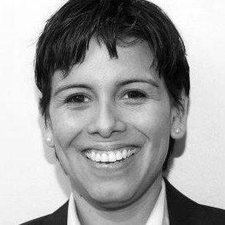
Land Tenure
Janina Mera

Slide 42
EG.10.4-7 Number of adults with legally recognized and documented tenure rights to land or marine areas, as a result of USG assistance.
Not restricted to individual ownership rights
Every adult counted separately
Official land registry data supplemented by activity records
Notes:
These two IM indicators are meant to align with SDG 1.4.2 and 5.a.1.
Land tenure security has been recognized as essential for ending poverty and hunger and achieving food security. There is also an important gender component to land tenure. Empirical evidence demonstrates that securing women’s property rights contributes to lower poverty and vulnerability and has positive consequences for women’s empowerment, nutritional and health outcomes, and children’s schooling.
The two IM indicators cover two aspects: Legal recognition and perception of security.
Both slides:
Should be measured at the individual and not the household level. If you report at the household level you run the risk of 1) incorrectly assigning rights and 2) underestimating both women’s and men’s rights and use of land.
Slide 1
---For legally recognized tenure regimes—for example the resguardos in Colombia where the indigenous people are granted a “community title”. There is only one title but many people within the community are covered under it. In this case , the IM would report all of the adult members of the community.
----Adult because have to be legally able to enter into a contractual agreement to have legal title for the first and for the second because we would like to

Slide 43
EG.10.4-8 Number of adults who perceive their tenure rights to land or marine areas as secure as a result of USG assistance
Potential gap between legal rights and perception of rights
Captured through a survey of beneficiaries
Notes:
Research has shown people’s perception of their security has as much impact on investment behavior as their legal status.
Key take away:
--There is frequently a gap between the legal rights and perceived rights so this is meant to measure that gap. For example, in many projects with a land focus, in male and female households, the land is titled jointly. However, the woman, may feel that while the land may be in her name it is de facto the mans. If the husband dies will the land be transferred to her or her male children? In case of a divorce, will the joint property be divided? There are many instances where culture dictates more than the legal framework.
Can also be collected from all participants via a census – doesn’t have to be a sample survey

Slide 44
Resilience
Janina Mera

Slide 45
RESIL-1: Number of host government or community-derived risk management plans formally proposed, adopted, implemented or institutionalized with USG assistance
Two types-government and community
Four phases of development: proposed, adopted, implemented, institutionalized (report under each stage within the year)
Plans can be implemented over more than one year.
Notes:
The official USAID definition of resilience is, “the ability of people, households, communities, systems and countries to mitigate, adapt to, and recover from shocks and stresses in a manner that reduces chronic vulnerability and facilitates inclusive growth”.
Just by looking at the definition we can see how it is difficult to measure. Since resilience is always in relation to a shock, measuring resilience requires an analytical approach that looks at the Absorptive, Adaptive, and Transformative capacities as proxies.
Specific to the Indicator:
Number of host government or community-derived risk management plans formally proposed, adopted, implemented or institutionalized with USG assistance
Risk Management plans impact beneficiaries by reducing beneficiaries’ exposure to shock. This indicator is important because risk exposure changes people’s behavior regardless of whether or not a shock actually occurs. Would you make investments that could increase your productivity in the long term if you have the threat of disaster hanging over your head in the short term? Surely, not. To reiterate; risk management plans impact behavior even when the shock does not occur.
Each plan should include the four elements of risk reduction strategies: prevention, mitigation, coping, and recovery. But what does that mean.
Let’s say you live in a flood prone area. If before the rainy season the community clears trash out of the waterways they 1) prevent, as much as possible, the risk of the shock occurring 2) reduce the fear of the shock occurring.
Prevention may work some years but it is impossible to prevent a 50-year drought for example. So then we move into the during a shock stage, what can we do to mitigate the damage caused by the shock. When that 50-year drought comes, maybe we don’t save all of the animals, selective destocking can prevent total loss. If you know your local/national government will buy animals at a fair price if a shock hits, your adversity to risk will decrease.
And after the shock what is in place to facilitate the speed of recovery.
Ideally risk management plans—should be nested---community plan in a local government plan, local government plan in a national plan.
Each plan can only be reported once, under its appropriate community or government disaggregate. If an IM is working on individual plans at the different levels—community, local government, national government-- they should all be reported. Emphasis on the individual plan.
A plan may be in multiple stages of implementation (proposed, adopted, implementation, institutionalization) throughout the year and each of the stages should be reported.
A plan can also be implemented in multiple years.
The end goal is institutionalization—where the host government or community internalizes the plan and takes over completely including financing. Government institutionalization should be more structured including a budget but community institutionalization will rely on more qualitative evidence.
Resilience Resources:
https://www.agrilinks.org/post/resilience-training-modules-now-available--
https://www.agrilinks.org/sites/default/files/resiliencemeasurementresources.pdf

Slide 46
Youth
Alexandria Schmall

Slide 47
YOUTH-3: Percentage of participants in USG-assisted programs designed to increase access to productive economic resources who are youth (15-29) [IM-level]
1/3 total global population (2.3 billion people) are ages 15-34
80% of young people live in low & middle-income countries
Agri-food sector (on/off-farm) is largest employer of youth, will continue to provide many opportunities (→ value chains)
Including youth in our work helps achieve GFSS objectives & Feed the Future outcomes
Cross-cutting Intermediate Result (IR) 4 “Increased youth empowerment & livelihoods”
New to engaging youth in agri-food systems? Check out our new guide!
Feed The Future Project Design Guide for Youth-Inclusive Agriculture and Food Systems Volume I and II
Notes:
YOUTH-3 - We are not trying to just count all youth we're working with, but only those participating in USG food security programs that meet the criteria of increasing access to "productive economic resources,” in order to engage youth in inclusive ag-led growth
-Go over PIRS
Bullet Points # 1 and 2 Why youth?
Point #3 youth in the agri-food sector. Youth need agriculture and agriculture needs youth.
For point #4
Youth inclusion magnifies Feed the Future outcomes by engaging young men & women as actors in inclusive agriculture-led economic growth (GFSS Objective 1)
Working-age youth are already important contributors to household livelihoods and resilience (GFSS Objective II)
Youth employment & engagement supports improved nutrition, especially of young women & children (GFSS Objective III)
For point #5
The purpose of the Guide is to enable USAID staff and implementing partners to intentionally consider the distinct aspirations, assets, opportunities, and barriers of youth populations when designing projects and activities in support of the US Feed the Future Initiative and the US government Global Food Security Strategy. The guide is structured as two volumes:
Volume I is intended to support Feed the Future staff (USAID Missions and others) to design youth inclusive programs based on the USAID project design cycle; and
Volume II offers implementation guidance for activity-level interventions, intended for USAID staff and implementers who may ultimately be managing activities and/or who wish to know more about youth-inclusive approaches to implementation in Feed the Future activities.

Slide 48
Additional Resources & Training
Notes:
We know that was a lot of information to cover and a lot of details, so we just want to point you to additional resources and training to ensure your full understanding. As always, our webinars are also recorded so you can go back and listen to anything again to refresh your memory.

Slide 49
Feed the Future MEL Webinar Series
Intro to the MEL System (recording available)
Standard Indicator Overview – Today!
New Indicators: Application of improved practices and technologies – June 13, 2018
New Indicators: Yield and geospatial
New Indicators: Sales and investment indicators
New Indicators: Gender
Nutrition Indicators
Learning Agenda
Market Systems Measurement
Annual FTFMS users webinar
Notes:
Here’s a list of the upcoming MEL webinars in this series. The full schedule is available online here: https://www.agrilinks.org/post/feed-the-future-mel-webinar-series

Slide 50
Have further questions?
Implementing Partners (IPs) -->> Contact your USAID Mission contact
USAID Mission staff -->> Contact your BFS MEL Technical Advisor (TA)
Notes:
If you have further questions, we’re here to help!
--All Implementing Partners should contact their USAID or USG contact with their questions.
--But USAID Mission staff or other USG staff can contact their BFS MEL Technical Advisor (TA).

Slide 51
Q&A
Notes:
Now we will leave the rest of the time for Q&A. We have some questions already typed in the chat box which we’ll address first, but please continue typing your questions directly in the chat box and we’ll get to as many as we can here.
(Julie starts reading /organizing questions).

