Slide 1
Food Systems and Nutrition:
Emerging Evidence and Research Opportunities
Presented by Shibani Ghosh, Ilana Cliffer, William A. Masters, and Johanna Andrews-Trevino, on behalf of The Innovation Lab for Nutrition
November 12, 2019

Slide 2
U.S. Government Partners

Slide 3
OUTLINE
Motivation and methods
Evidence to date and research opportunities ahead
Production and processing of nutrient-rich foods
Agriculture-nutrition linkages at population scale
Food safety, loss and waste
Gender, resilience, and sustainability
3. Metrics and indicators for agriculture, food systems and nutrition

Slide 4
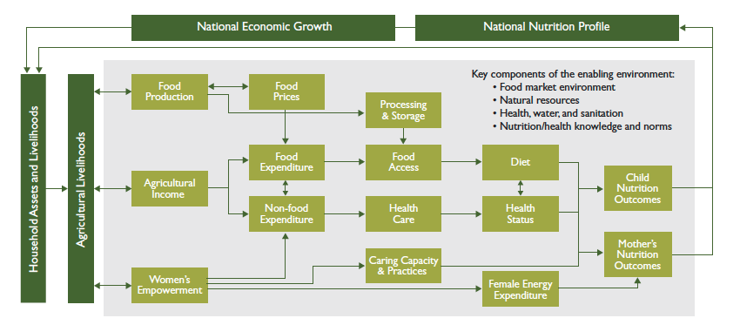
Evidence reviewed in this report
Agriculture-nutrition pathways guiding post-2008 actions
Source: Linking Agriculture & Nutrition: Pathways, Principles, Practice (Herforth & Harris, 2014)

Slide 5
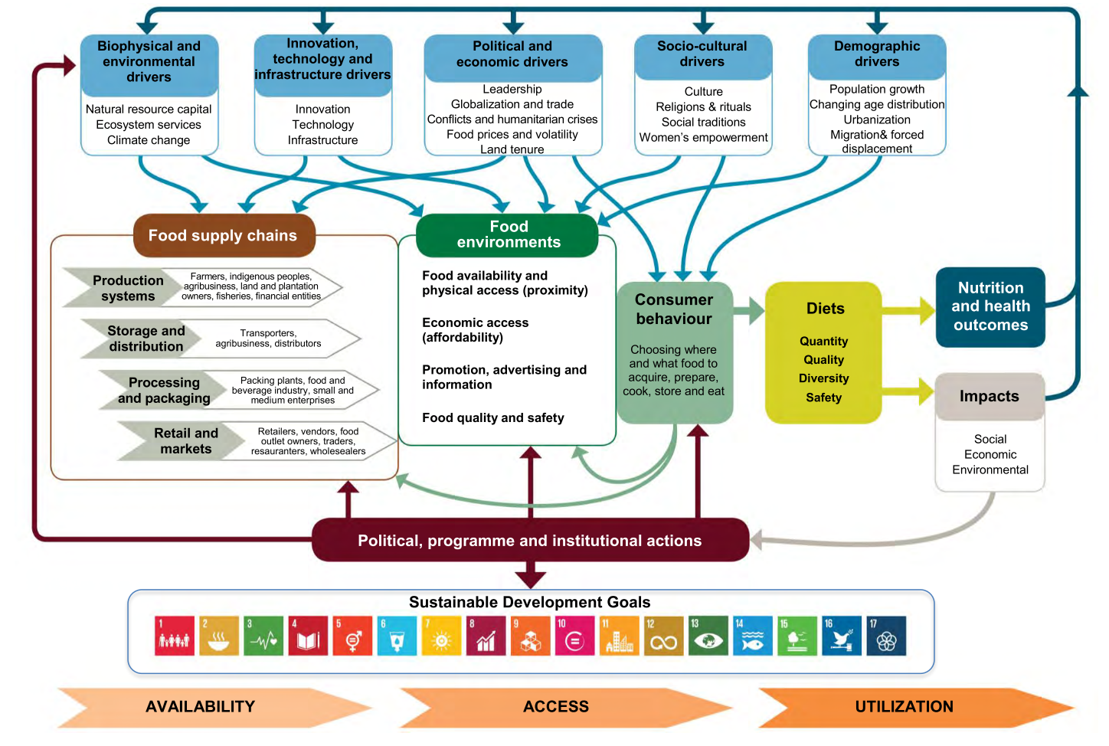
Why focus on food systems?
Food systems interactions proposed by HLPE 2017
Source: High Level Panel of Experts on Food Security and Nutrition of the Committee on World Food Security, 2017.

Slide 6
USAID global food security strategy results framework
Source: Results Framework for the U.S. Government Global Food Security Strategy

Slide 7
Definitions
Food and nutrition security
Resilience
Nutrition-specific interventions
Nutrition-sensitive interventions
Food value chain
Food environment
Food systems
Sustainable food system

Slide 8
METHODS
First round of searches:
Systematic reviews on food systems-nutrition linkages from 2014-2019
Examples: food systems + nutrition, global food systems, sustainable food systems
Broader literature on food systems, prices, and markets
Second round: refined terminology to search for literature related to specific sectors
Examples: food environment, food production + nutrition, sustainable diets, nutrition sensitive agriculture, women’s empowerment + agriculture, market access…
Total of 532 documents identified based on titles, 167 included in review after reviewing abstracts

Slide 9
Production and processing of nutrient-rich foods

Slide 10
How do crop genetics, biotechnologies, and agronomic management influence nutritional status?
Evidence:
Crop improvement (primarily focused on starchy staples and oils) has been a major driver of poverty reduction & food security
Biofortification & other production changes can have positive effects on micronutrient status, effects on child growth are less proven
Land ownership, gender dynamics, water management and productivity-enhancing inputs are crucial for poverty reduction but have little effect on nutritional status
Research opportunities:
Potential and effectiveness of increasing micronutrient adequacy through biofortification, versus dietary diversification
How to increase consumer demand, food systems, and farm production of crops with desirable nutritional attributes
Establish causal linkages and investigate impact pathways between land use, productivity inputs, and food security, diet and nutrition

Slide 11
How do livestock interventions influence nutrition?
Evidence:
Relationship between livestock ownership and human health is complex
Can improve linear growth through increased milk consumption and income effects
Diarrheal disease from repeated fecal-oral transmission or zoonotic transmission of other animal diseases to humans can have negative effects on health and growth
Positive association between intake of animal sourced foods and growth of children; quantities & timing of consumption & complementary conditions needed to reduce stunting not yet demonstrated
Research opportunities:
Field testing, risk assessment, and cost-effectiveness analysis of livestock interventions and animal-sourced food market development on health and nutrition
Measure & mitigate potential harms of livestock on nutrition and health (gastrointestinal conditions and zoonotic and vector-borne infection risk)

Slide 12
Is market access an intervening variable between agricultural production and consumption?
Evidence:
Market access positively associated with diet diversity, likely through increased purchases of nutritious foods to fill gaps in own production
Investments in agricultural diversification likely to be most effective if they target households least connected to markets; in places with market access diet diversification through farm diversification could limit income from other activities
Research opportunities:
Improve data collection on use of markets by different types of farm households
Determine how market utilization links to household production and consumption
Examine how food environments and attributes of markets (number of vendors, amenities at the marketplace, items available, etc.) affect diet and nutritional outcomes

Slide 13
Do homestead food production programs aimed at increasing household production of diverse foods impact nutritional status?
Evidence:
Training and inputs for homestead gardening and home livestock production have shown positive impacts on farm and diet diversity, animal ownership, and women’s empowerment
Magnitudes of impact relative to cost are low in terms of anthropometric outcomes and diet quality; farmers would have to add 16 additional crops to their production to increase diet diversity by just one food group
Research opportunities:
Identify where and when homestead food production is most cost-effective and sustainable compared to other nutrition interventions
Determine effectiveness of integrating homestead food production and nutrition sensitive agricultural interventions into a broader food systems approach

Slide 14
What evidence is there about the effects of food processing on nutrition?
Evidence:
Processing can improve food safety by destroying pathogens and protecting against contaminants, and alter nutritional attributes (transforming ingredients, removing or adding components)
Fermentation and milling can increase bioavailability of nutrients, and facilitate fortification with added micronutrients
Increases in sugar and refined starches, salt, and other components designed to improve palatability and shelf-life can increase risk of cardiometabolic diseases and some cancers
Research opportunities:
Understand drivers of change in the food environment across diverse rural and urban areas
Investigate how food processing and packaging technologies can improve nutrition and reduce costs and waste in the food system
Assess cost-effectiveness of food fortification relative to dietary diversification

Slide 15
Questions on Production and processing of nutrient-rich foods

Slide 16
Agriculture-nutrition linkages at population scale

Slide 17
How do trade policies, markets, and food prices impact food availability, and ultimately nutritional status?
Evidence:
More open trade generally helps stabilize food prices and nutrition security but is costly to specific interest groups, while benefits are diffuse
Trade and cross-border investment in the food industry has contributed to obesity and chronic disease through increased accessibility of cheap, non-nutritious packaged and processed foods
Little evidence on how markets and infrastructure have impacted food prices, food safety and quality, or nutritional status
Research opportunities:
Estimation of effects of trade policies, market infrastructure, and other systemic interventions on diet quality and nutritional outcomes
Understanding the role of multinational and local intermediaries between producers and consumers on nutrition outcomes
Determining net effects of infrastructure, policies and programs on overall diet cost and affordability

Slide 18
What evidence is there about ways to reduce constraints on producing and consuming a variety of nutrient-rich foods?
Evidence:
More nutritious food groups tend to have high costs of production, transport and storage
Even with technological improvements that could lower costs of nutritious foods, quality assurance and other constraints may limit strategic production and access to safe and nutritious foods
Research opportunities:
Identify how market information and quality assurance could help link farmers to new consumer demand for more nutritious foods
Better understand pros and cons of contract farming and ways to link production methods to consumer demand

Slide 19
What levers can shape consumer demand for nutrient-rich foods?
Evidence:
Food environments shape preferences and demand for different types of food
Income and prices also play a key role in food choice, and can be modified by safety nets, taxes and subsidies
Little evidence on effectiveness of food choice interventions in LMICs
Research opportunities:
Conduct real-world experiments on food choice and responses to intervention in LMICs
Understand the role of time costs, convenience, storage and food waste in food choice and nutrition transition
Investigate how food companies change the food environment in response to policies and programs

Slide 20
Questions on
Agriculture-nutrition linkages
at population scale

Slide 21
Food safety, loss and waste

Slide 22
What is the link between food safety during production and nutrition?
Evidence:
Poor food handling, unsafe water quality and soil contaminants are an area of concern
Animal sourced foods are highly susceptible to foodborne pathogens, can be contaminated with toxins, and can contribute to antimicrobial resistance
Research opportunities:
Determine methods of reducing water and irrigation related food safety issues and investigate dietary consequences of exposure to pesticides
Research interventions necessary to reduce food safety risks associated with consumption of contaminated livestock products and the impacts of antibiotic use in livestock production

Slide 23
What are the food safety issues that affect nutrition in the post-harvest phase, and how can they be mitigated?
Evidence:
Poor sanitary facilities, use of unsafe water to wash or process fruits and vegetables and poor personal hygiene may result in food contamination
Poor agricultural practices, particularly inadequate drying and sub-optimal storage conditions can result in mycotoxin production
Research opportunities:
Add to the evidence base on how to best prevent mycotoxin exposure from impacting human health and the role of mycotoxins in the pathogenesis of EED and childhood stunting
Determine methods to enforce mycotoxin regulations among farmers in LMICs and identify cost-effective interventions and practices can help smallholders better understand and manage food safety threats

Slide 24
How are marketplace food safety issues related to nutritional status?
Evidence:
If markets lack appropriate infrastructure and vendors sell expired foods, food safety can be compromised
Poor hygiene practices by traders and vendors can result in a transfer of pathogens to produce
Research opportunities:
Understand how to better encourage food vendors to achieve food safety in the marketplace with limited infrastructure and study the role of sales of expired foods on nutrition
Update research on hygiene practices among food vendors, and how this is related to nutritional status

Slide 25
How is food safety in the home connected to nutritional status?
Evidence:
Poor personal hygiene and use of unsafe water can result in microbial contamination of perishable foods
Foods can also be contaminated with mycotoxins
Research opportunities:
Research causal pathways from poor food safety, WASH and health and nutrition outcomes such as childhood stunting
Assess the potential to scale up the prevention of absorption of aflatoxin after ingestion

Slide 26
How have advancements in technologies used at the household level mitigated post-harvest loss and impacted the availability of nutrient-rich foods?
Evidence:
Cereals are still a majority of the food supply and account for most of the food loss
Technologies and infrastructure improvements lower transactions costs and minimize post-harvest losses
Research opportunities:
Rigorous post-harvest loss assessments throughout the value chain of multiple commodities of nutritional importance
In-depth systems assessment of cold chains
Determine different types of incentives for growers to adopt on-farm practices to reduce food loss

Slide 27
How can population-level interventions minimize food loss?
Evidence:
Improvements to market infrastructure and technology can reduce food loss
Research opportunities:
Better measurement of food losses to establish a firm evidence base from which to assess food loss and waste globally
Understand the impact of market transformation and improvements to infrastructure on food loss
Assess the feasibility, cost-effectiveness and scalability of innovations in post-harvest technologies for increasing production, access and availability of fruits, vegetables, and animal-sourced foods

Slide 28
Questions on food safety, loss and waste

Slide 29
Cross-cutting themes: 1. Gender, resilience, and sustainability 2. metrics and indicators for agriculture, food systems and nutrition

Slide 30
What evidence is there for the role of gender in food systems-nutrition linkages?
Evidence:
Lack of access to credit and power to make credit related decisions, excessive workloads and a low prevalence of group membership (WEAI analysis)
Women’s time and energy stress lead to reduction in caregiving practices and risks to her own health
Absence of indicators of time resource allocation, reproductive decision making and indicators of men’s engagement in child care and nutrition
Research Opportunities:
Design services that engage with and can be accessed by women producers.
Qualitative studies on the context-dependent interplays between gender dynamics, food systems and nutrition pathways
Impacts of agricultural interventions on women’s workload, childcare, and time burdens.
Analysis of gender as a mediator of agriculture to nutrition

Slide 31
How can food systems lead to resilience and ensure sustainability?
Evidence:
Links short term changes to long term sustainability and socio-economic security to agro-ecological changes
Agricultural production diversity is a crucial dimension of resilience and nutrition
Reduces risks of pest and pathogen outbreaks,
Allow for more security with increasing climate variability and weather events
Two thirds of the global dietary energy intake from rice, maize and wheat while global supply of pulses, fruits and vegetables fall short of recommended requirements
New recommendations to promote more nutrient dense vegetable-based diets that are healthier and environmentally more sustainable
Research Opportunities:
Modeling scenarios of optimal on-farm crop mixtures and rotations that are most beneficial for improved resilience by region, considering current patterns in climate variability.
What support systems are needed to incentivize more diverse cropping systems in small holder farmers?
Food systems modeling to assess tradeoffs in supporting healthy diets versus promoting resilience and sustainability

Slide 32
What are the needs around metrics and indicators in agriculture, food systems and nutrition?
Evidence:
Successful and meaningful research in the realm of agriculture, food systems and nutrition require robust and appropriate indicators
Measurement of the entire pathway of change from agricultural inputs and practices through nutrition outcomes
More measures of diet quality (household and individual) but household diet assessment measurement is still inconsistent
Little emphasis on measures of natural resource management (e.g. water access, quality- significant effects on disease vectors, time, labor)
Use of anthropometry and insufficient duration of the intervention, need to go beyond anthropometry
Research Opportunities:
Guidance and research to harmonize food group and dietary diversity indicators (individual, household, market and systems level indicators)
Use and contextualization of standardized indices for evaluating market interventions including affordability of nutritious diets
Define longer term outcomes and better measures of wellbeing including neuro-cognition, body composition and other anthropometric measurements such as head circumference.

Slide 33
Question on cross cutting themes

